Slide 1

Everett Water Supply Resiliency
Souheil Nasr, P.E.
Everett Public Works
March 25, 2019

Slide 2
Resiliency Parameters
Critical/essential facilities
Designed to resist earthquakes with 2% chance in 50 years
Equivalent to M_{w}7.4 SWIF earthquake

Slide 3
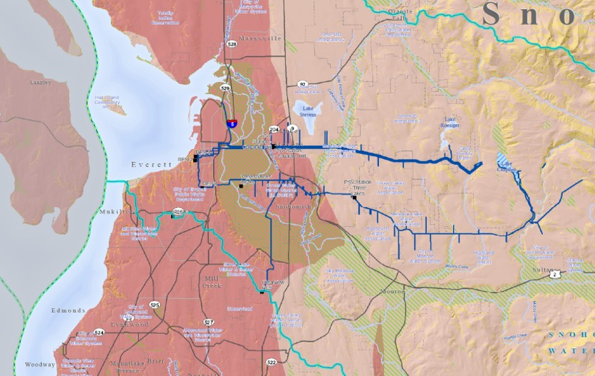
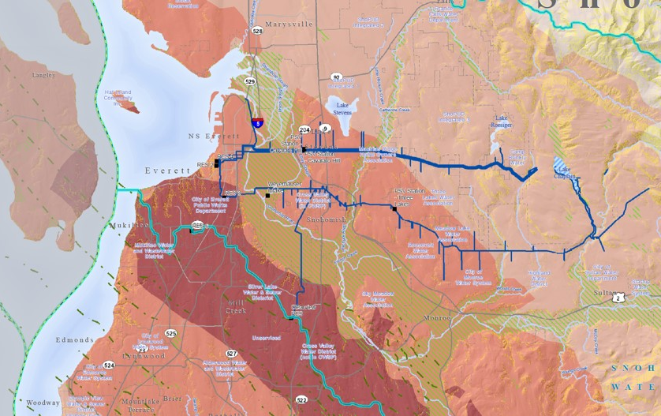
Earthquakes Considered
Cascadia Earthquake
South Whidbey Island Fault
M_{w}9.0 CSZ, PGA 18-34 %g
M_{w}7.4 SWIF, PGA 65-124 %g
M_{w}7.4 SWIF is 3 – 4 times more violent than M_{w}9.0 CSZ

Slide 4
Importance Post-EQ Water Supply
Public health
Fire fighting
Economic continuity

Slide 5
Everett Earthquake Likelihood
In next 50 years (USGS):
  14% chance of M_{w}9.0 CSZ
  15% chance of M_{w}6.5+ surface fault
  85% chance >1 deep earthquake

Slide 6
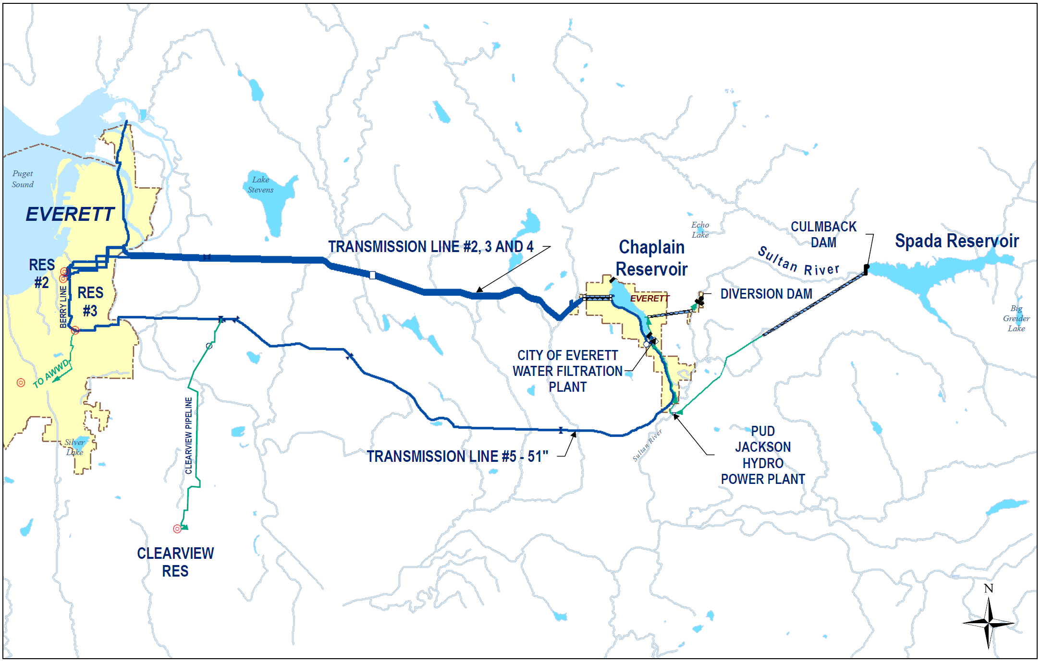
Everett Water Supply System

Slide 7
Resiliency Project Findings
M_{w}7.4 SWIF earthquake:
  Res 2 complete damage
  Res 3 & 6 extensive damage
  Chaplain N&S dams extensive damage
  WFP moderate damage
  20+ breaks/leaks in TLs

Slide 8
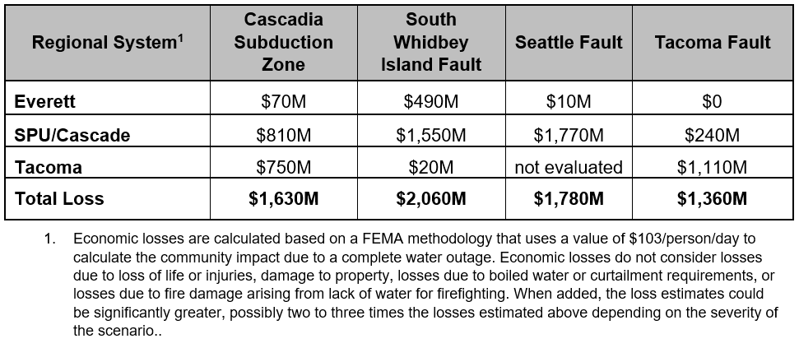
Economic Cost
  WFP building extensive damage
  WPCF moderate damage
  20+ breaks and leaks
  Clearview reservoir extensive damage
  30+ breaks/leaks in Clearview line

Slide 9
Everett Seismic Mitigation
TLs 2 & 3 - 2009
Pile-supported TL 5 - 2010
Water supply risk assessment - 2012
WFP OP bldg. seismic retrofit - 2017

Slide 10
Everett Seismic Mitigation
Resiliency study – 2016/2018
Distribution main replacement with earthquake resistant pipe - now
Replace Res 2 – in design

Slide 11
Short Term (10 Yrs)Mitigation Plan
Enhance preparedness & response
  Finalize earthquake response plan
  Augment TL repair material stocks
  Assess emergency drinking water
Implement resiliency CIP program Totaling $94 Million over 10 Yrs

Slide 12
Short Term (10 Yrs) Mitigation Plan
Implement water isolation strategies
  Isolation valves at Res 2, 3 & 6
  EQ resistant distribution system
  Add strategic valves for isolating
Keep Res 4 as non-potable storage

Slide 13
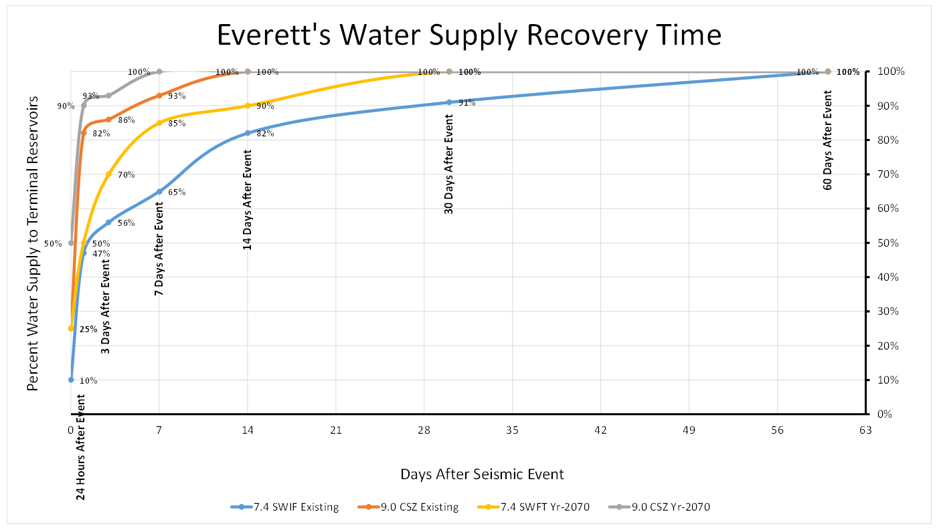
Water Supply Recovery Curves
M_{w}9.0 CSZ earthquake
  PGAs <0.2 in Everett’s system
  Reservoir 2 complete damage
  Up to 15 breaks & leaks

Slide 14
Long Term (50 Yrs) Mitigation Plan
Backbone Distribution System
  Use earthquake resistant pipe
  Implement isolation strategy
Upgrade/replace vulnerable facilities
  Reservoirs 3, 6
  Key pump stations & support facilities

Slide 15
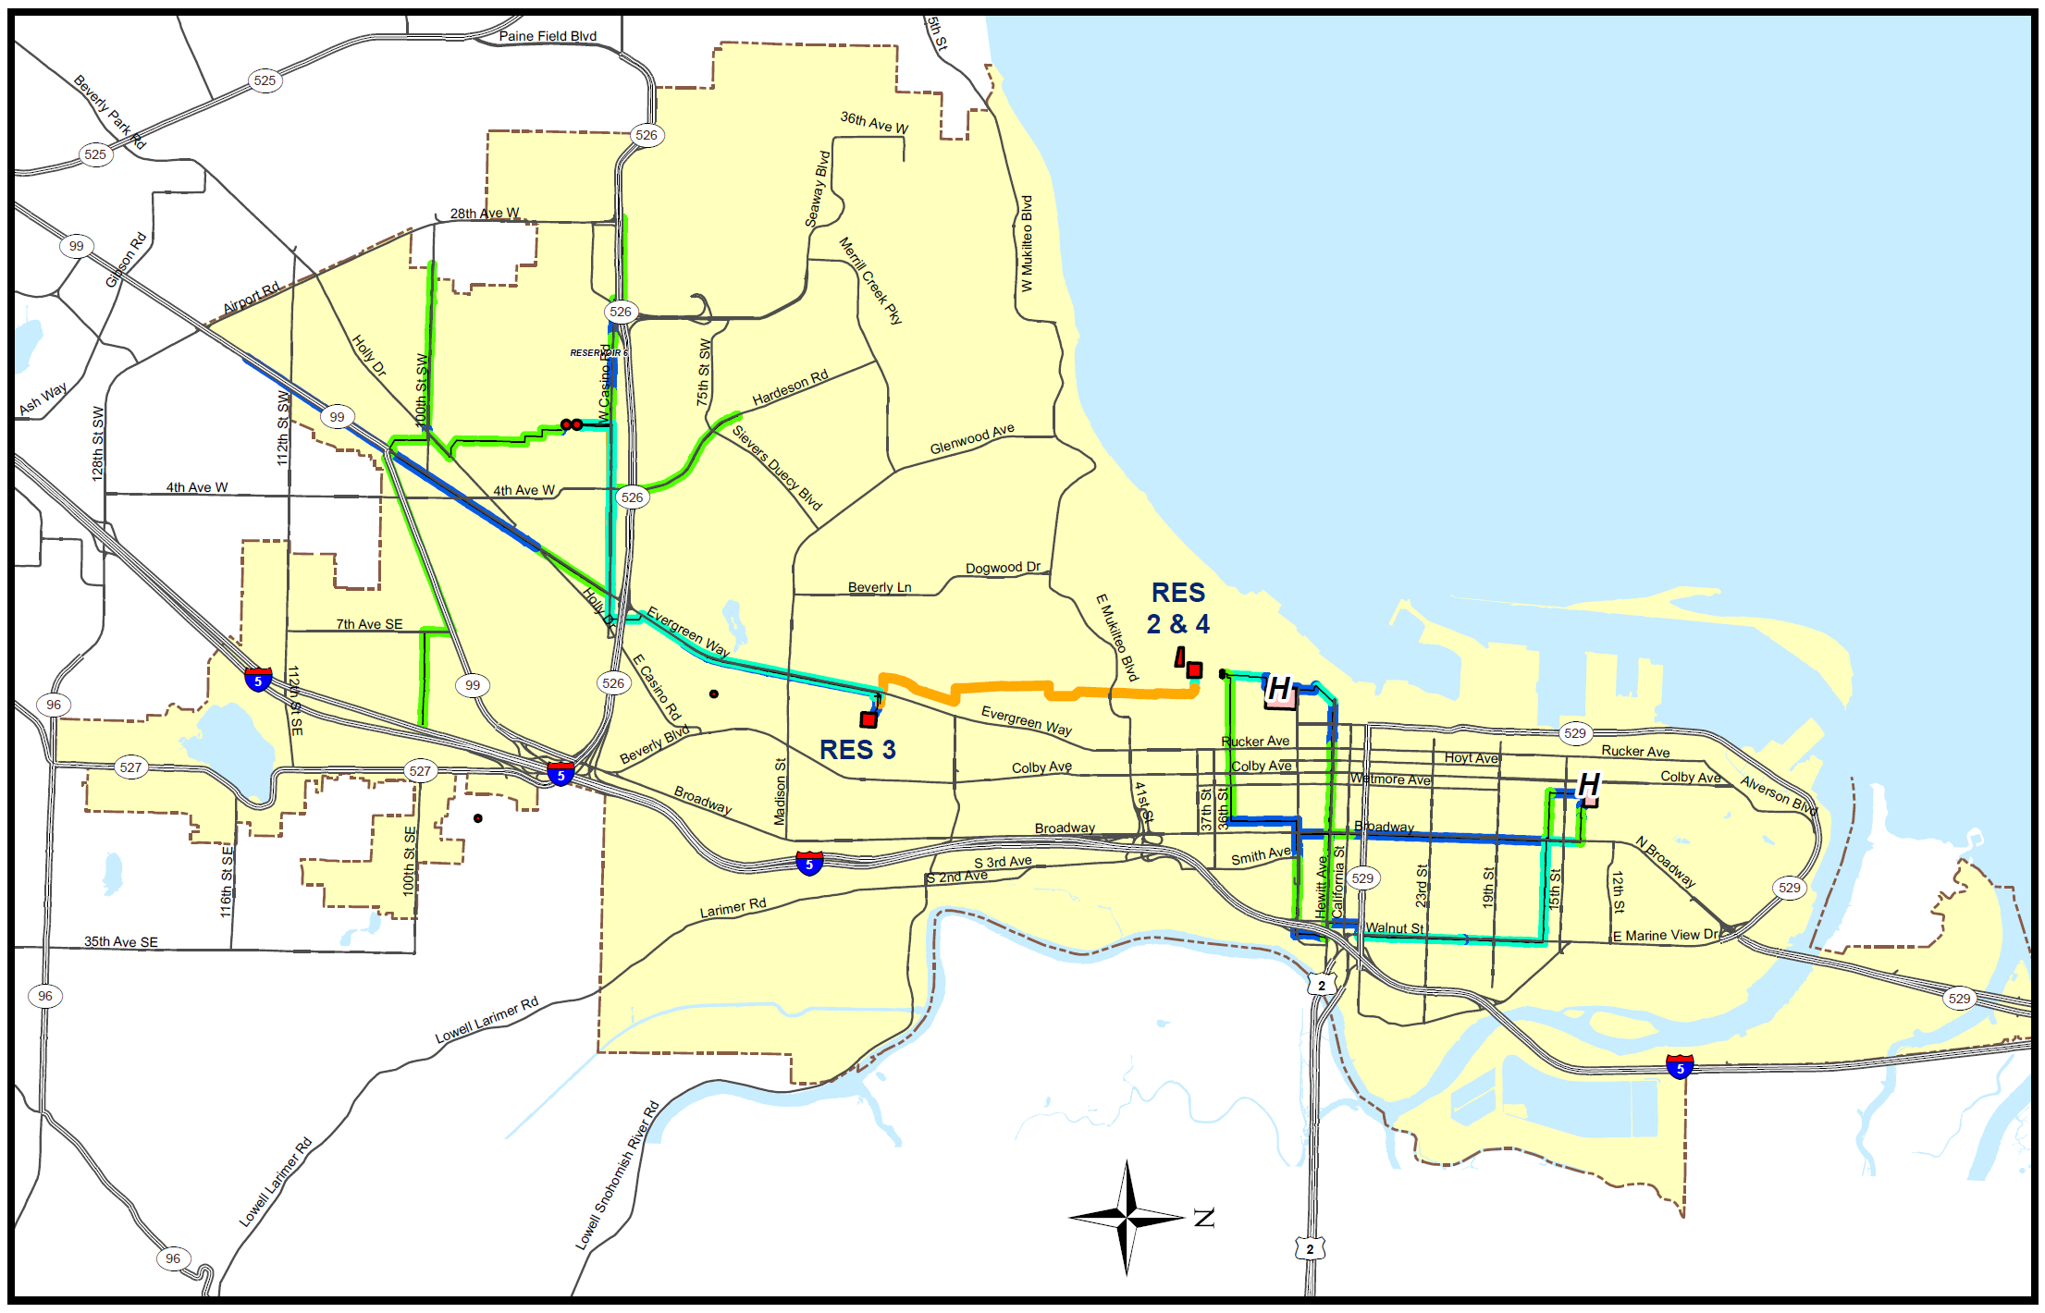
Everett Water Backbone System

Slide 16
Summary
Seismic planning is a long term priority
Seismic projects are in the water CIP
Seismic planning is a city-wide effort

Slide 17
Questions?

