Slide 1
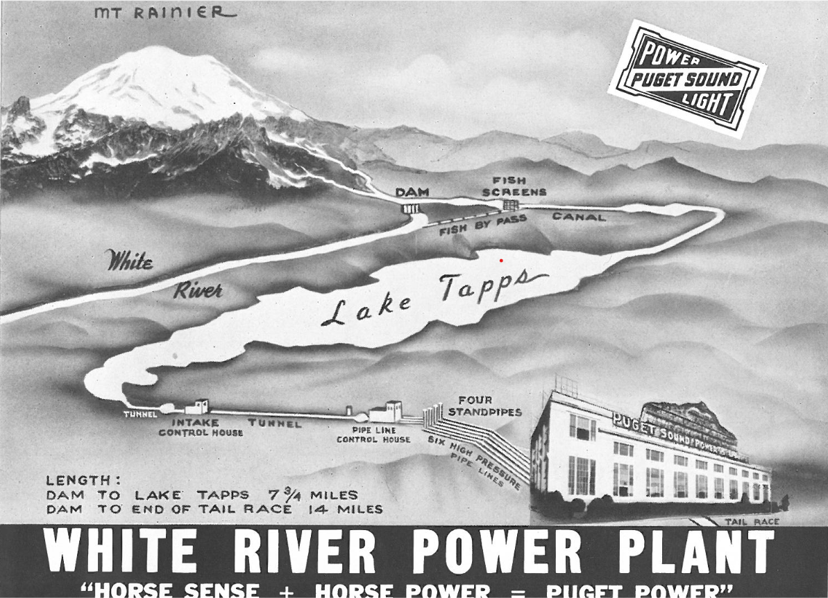
White River – Lake Tapps Reservoir
Historical Photos

Slide 3
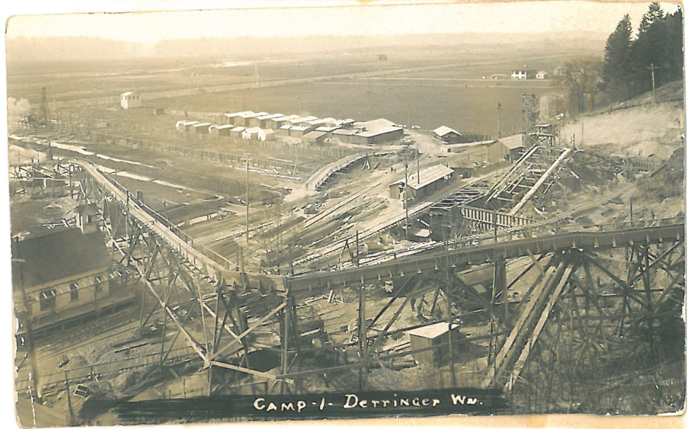
There were 17 camps located along the project area. Derringer Camp was Camp #1. Sluicing hillside for pipes and construction of Powerhouse, 7-20-1910

Slide 4
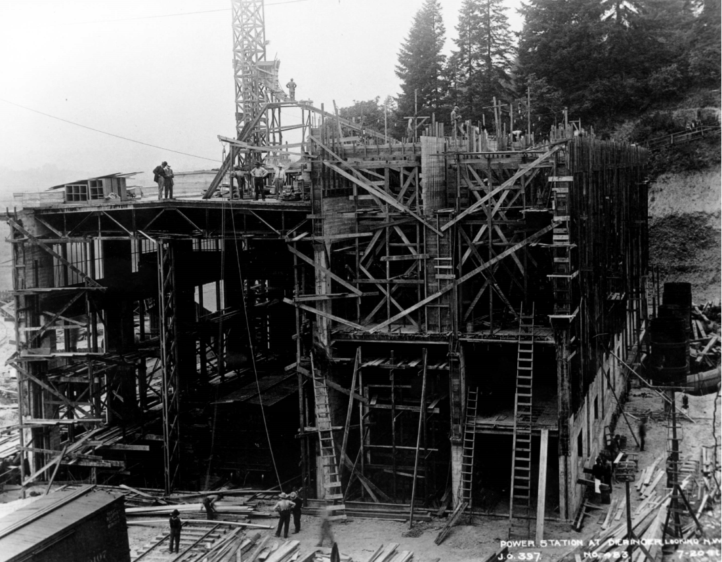
Powerhouse construction 7-20-1911

Slide 5
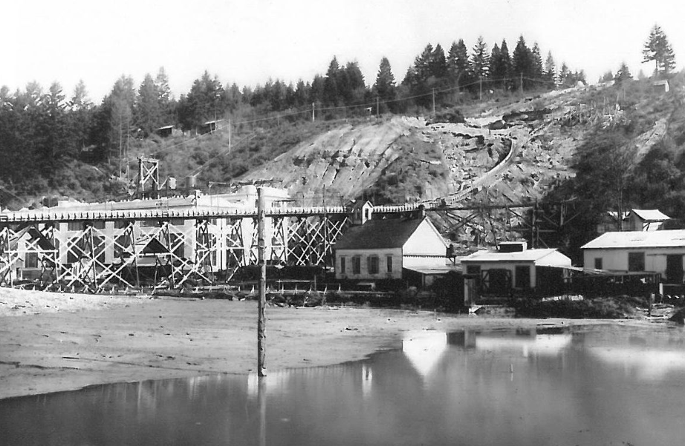
Powerhouse construction and admin buildings, 1911

Slide 6
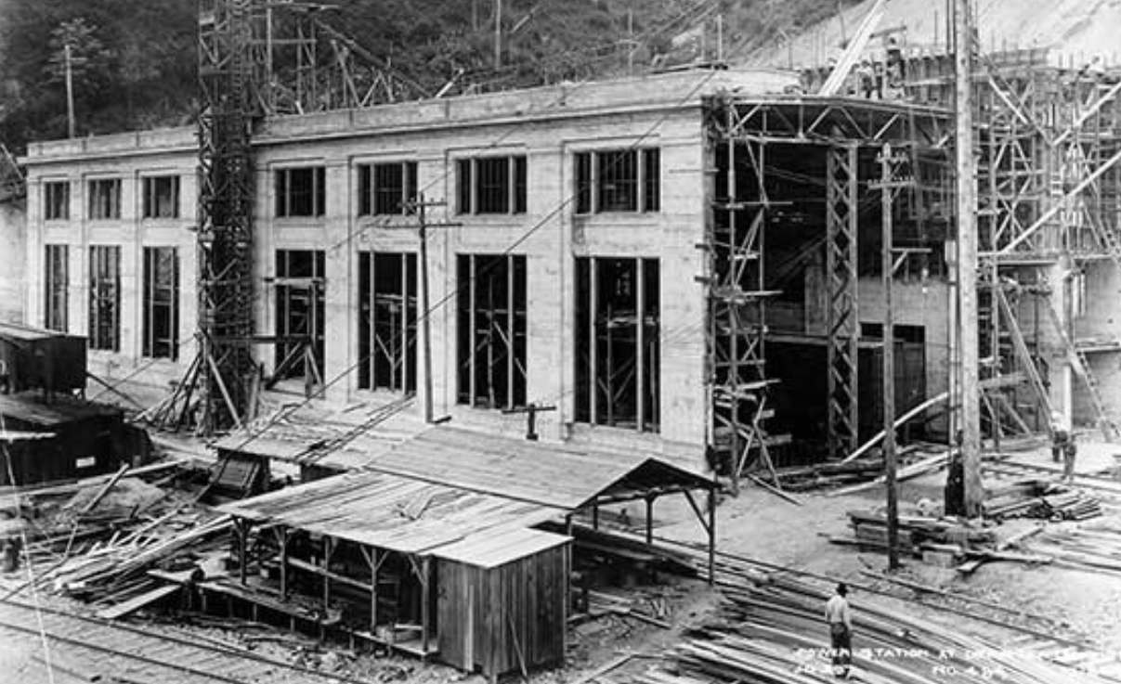
Powerhouse construction, 1911

Slide 7
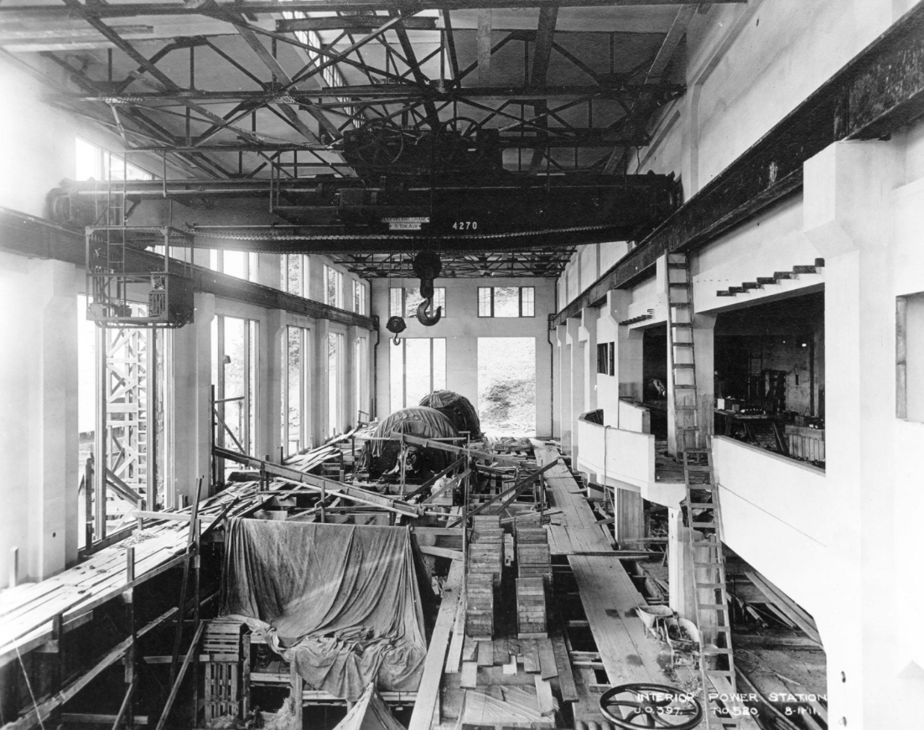
Powerhouse construction, 8-11-1911

Slide 8
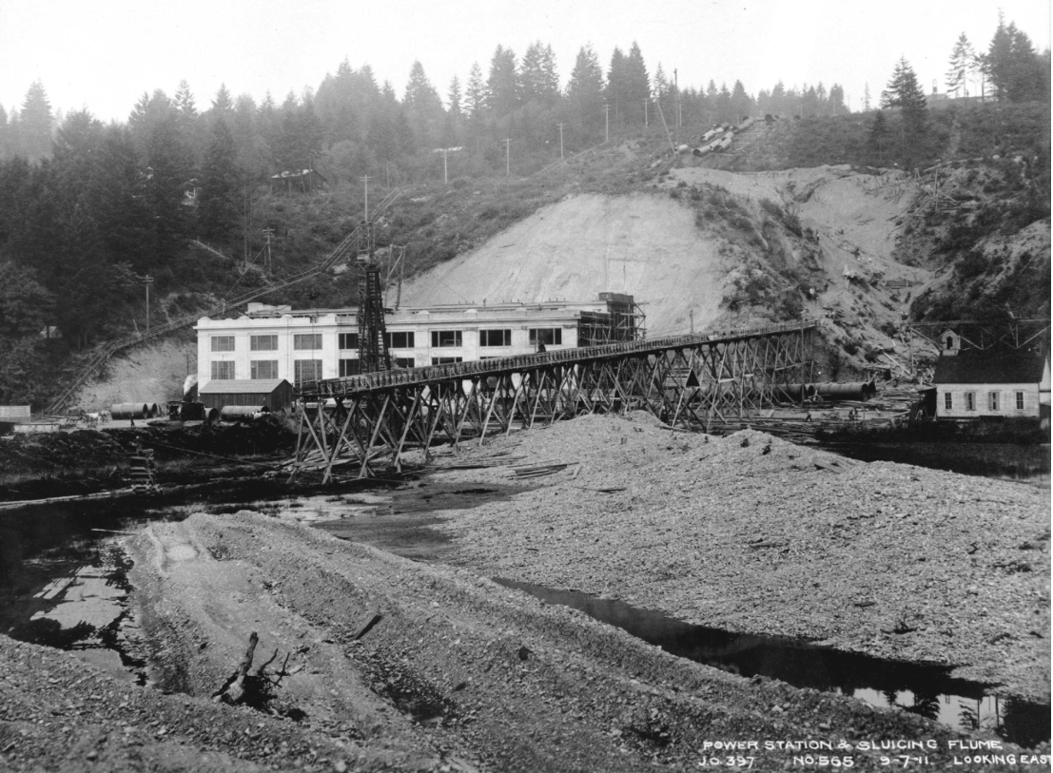
There is a wooden footbridge to the left and water sluiced the hillside to the right so maximum velocity could be achieved from the falling water for power production. The trestle is part of the incline railway, which used a 25-ton electric hoist to pull heavy locomotives and steam shovels from the valley floor up to Lake Tapps.

Slide 9
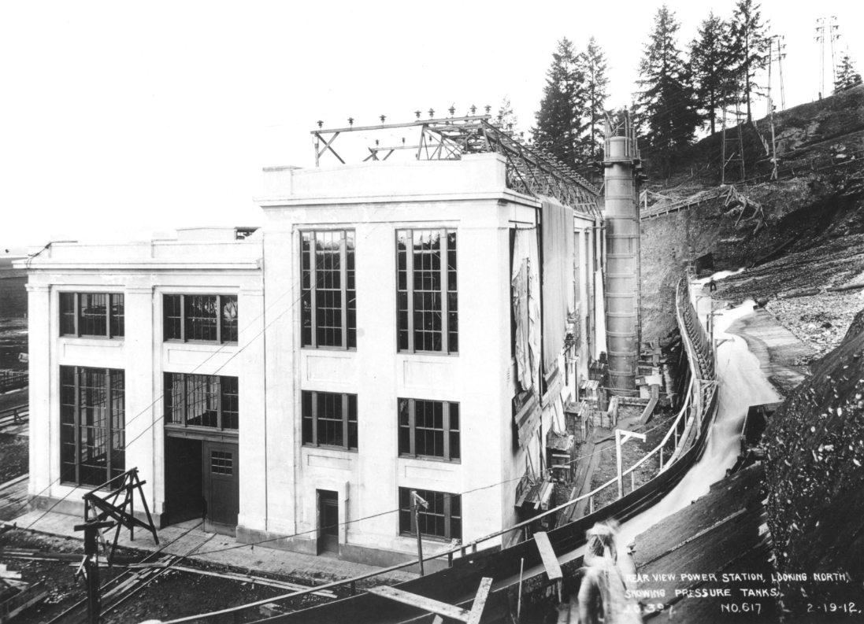
High-pressure water sluicing the hillside behind the Powerhouse, 2-19-1912

Slide 10
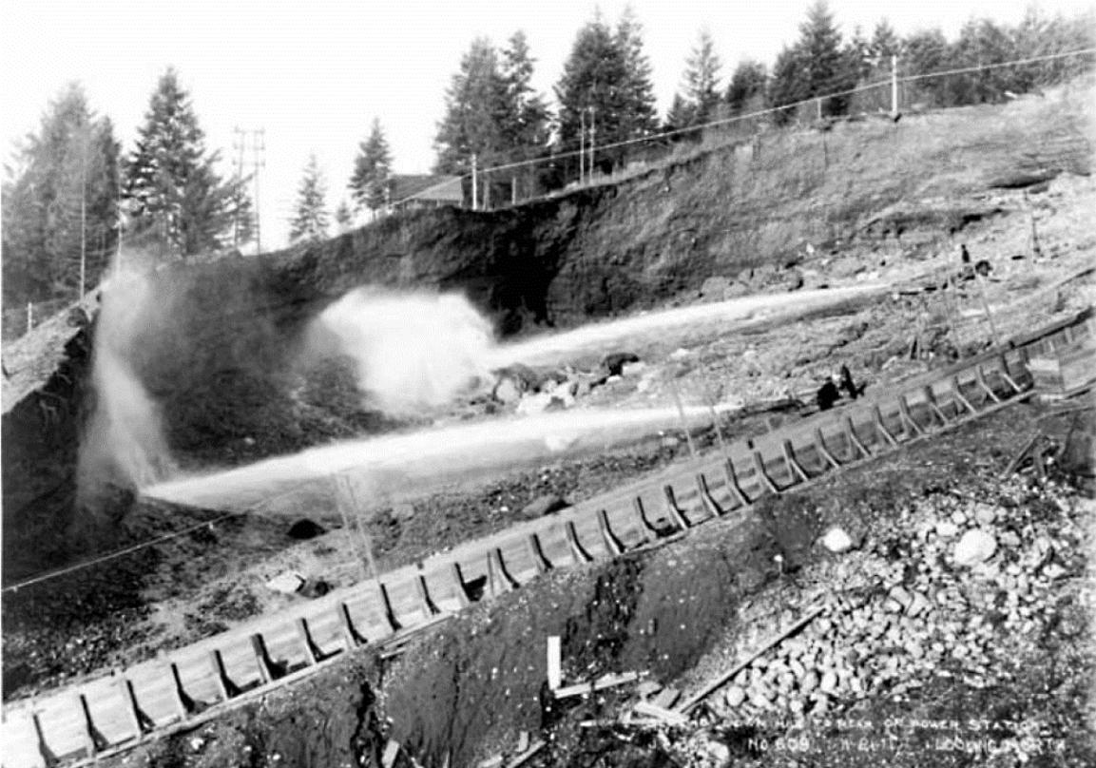
High-pressure water sluicing the hillside behind the Powerhouse, 11-21-1911

Slide 11
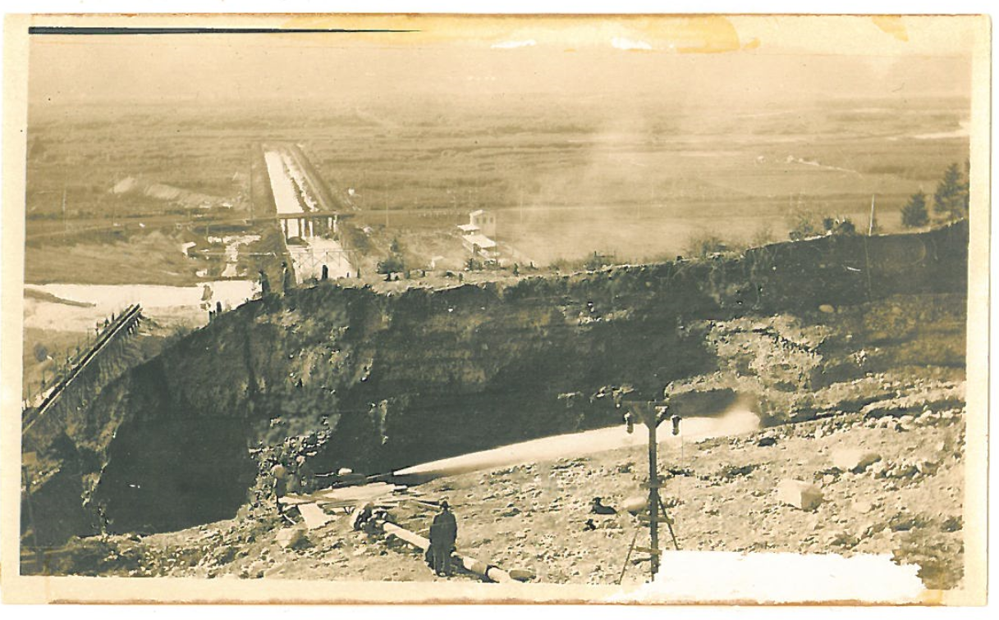
View looking west showing hydraulic excavation of hill above Powerhouse

Slide 12
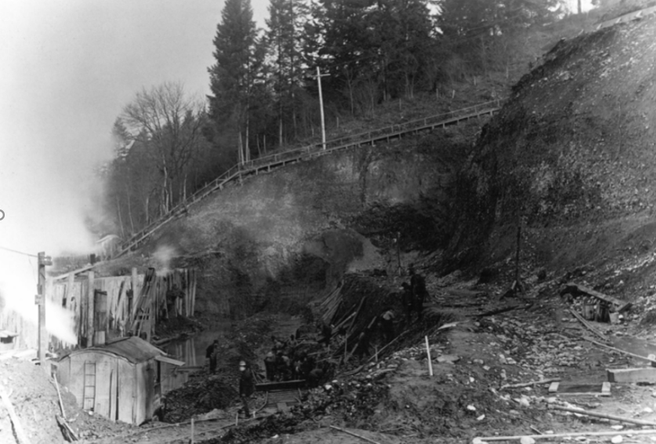
View looking north showing excavation of hill above Powerhouse

Slide 13
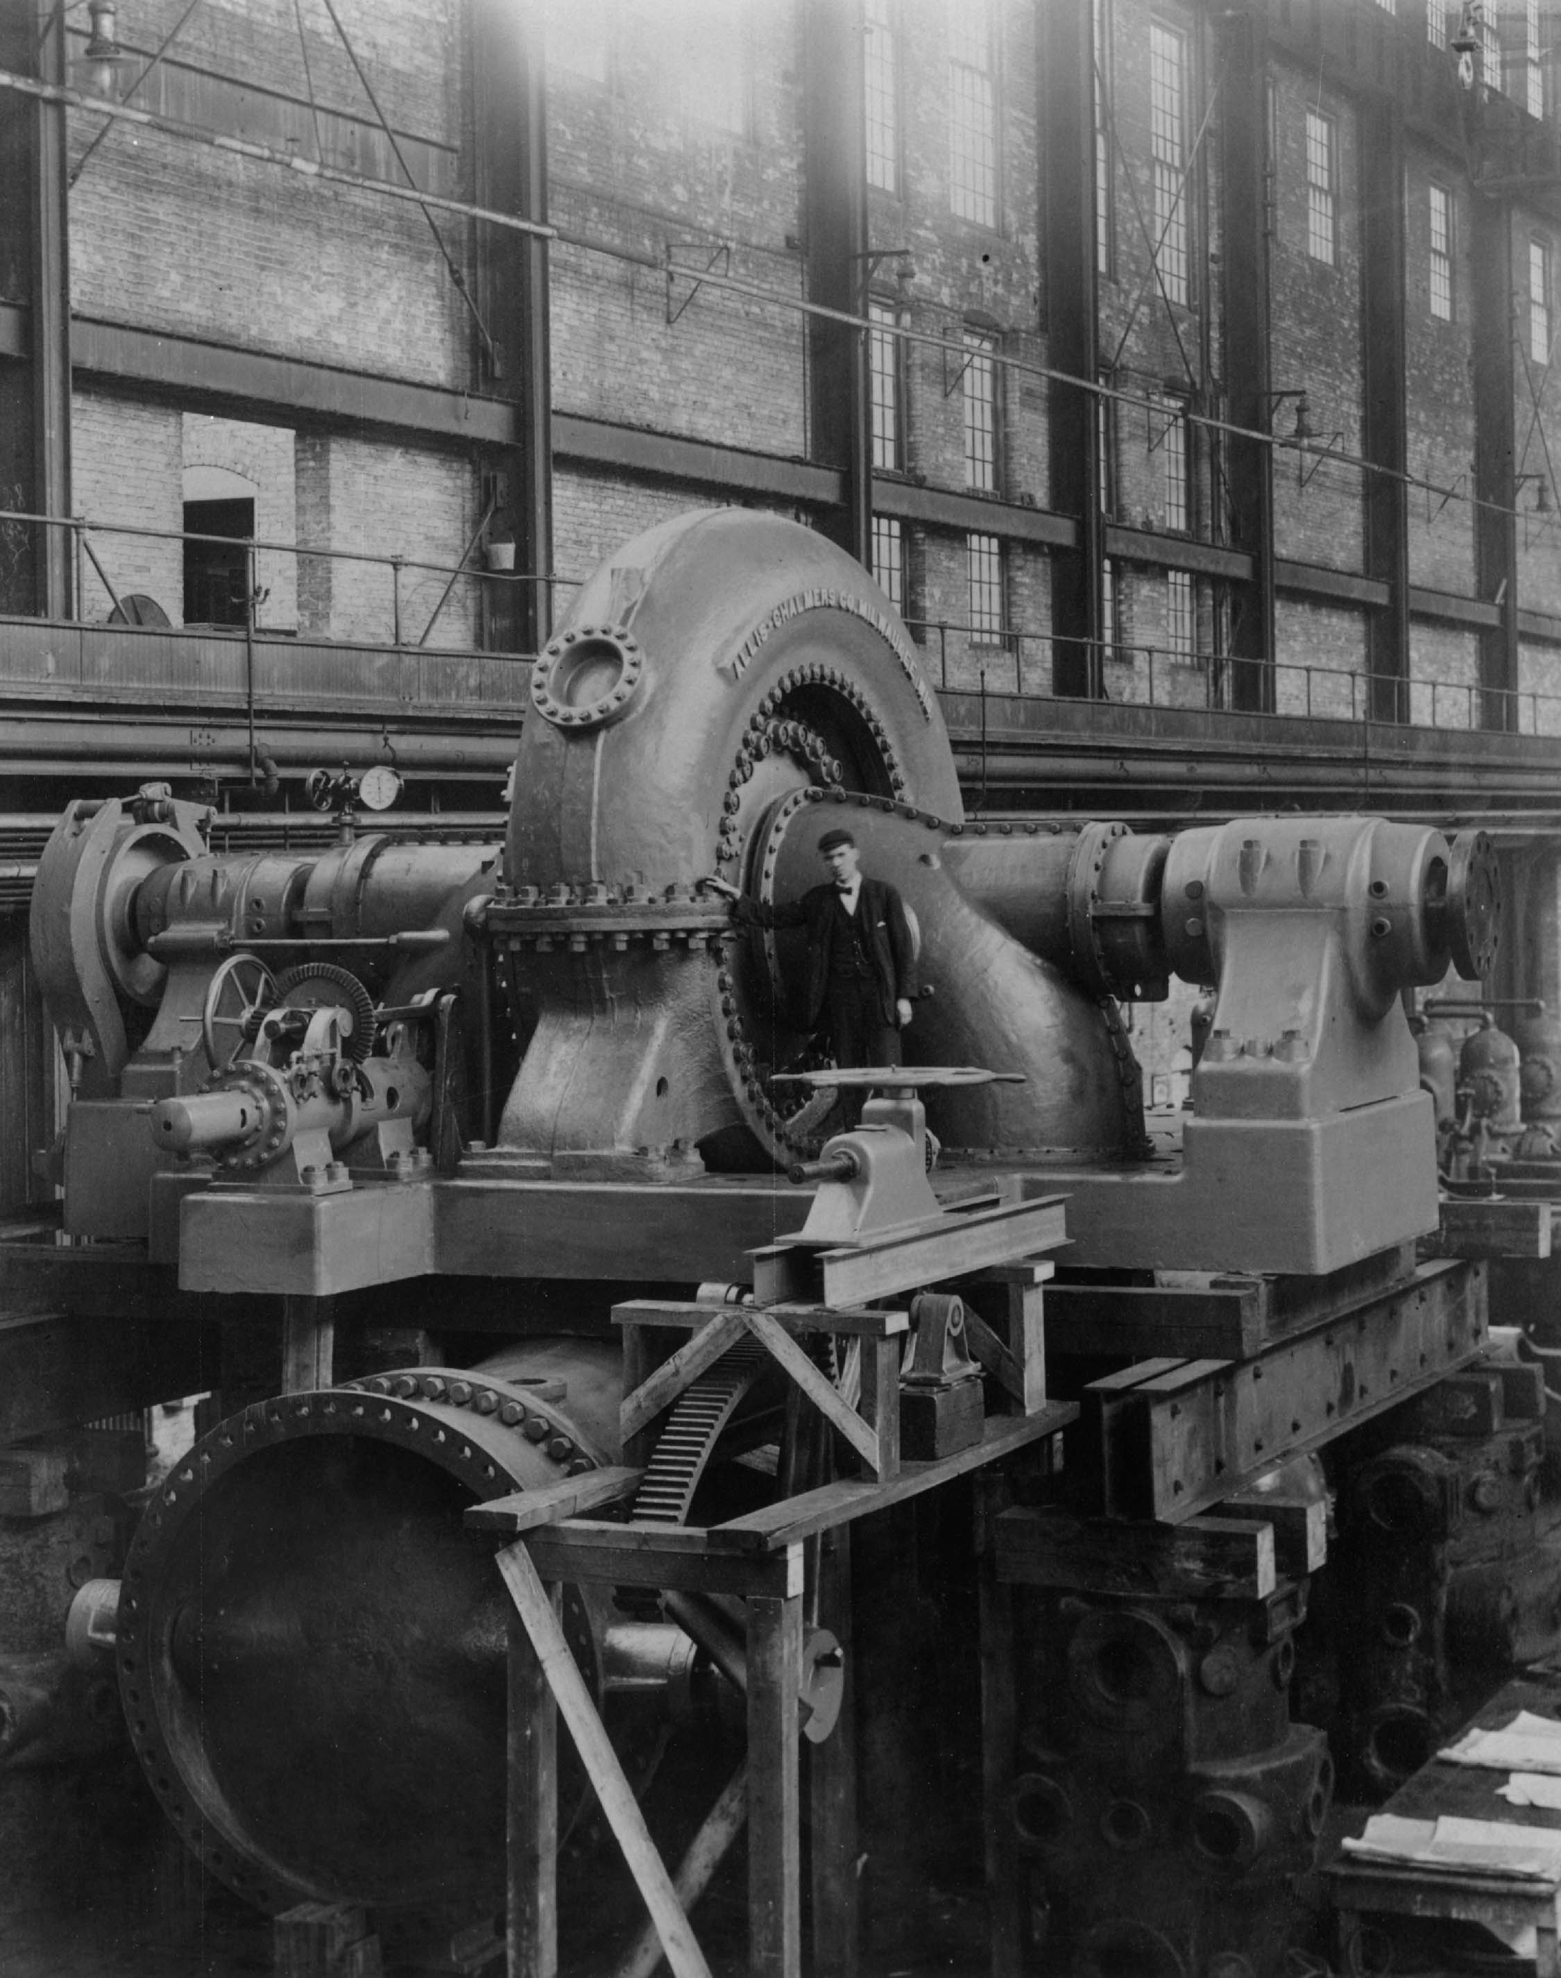
Powerhouse turbine #1, 1911

Slide 14
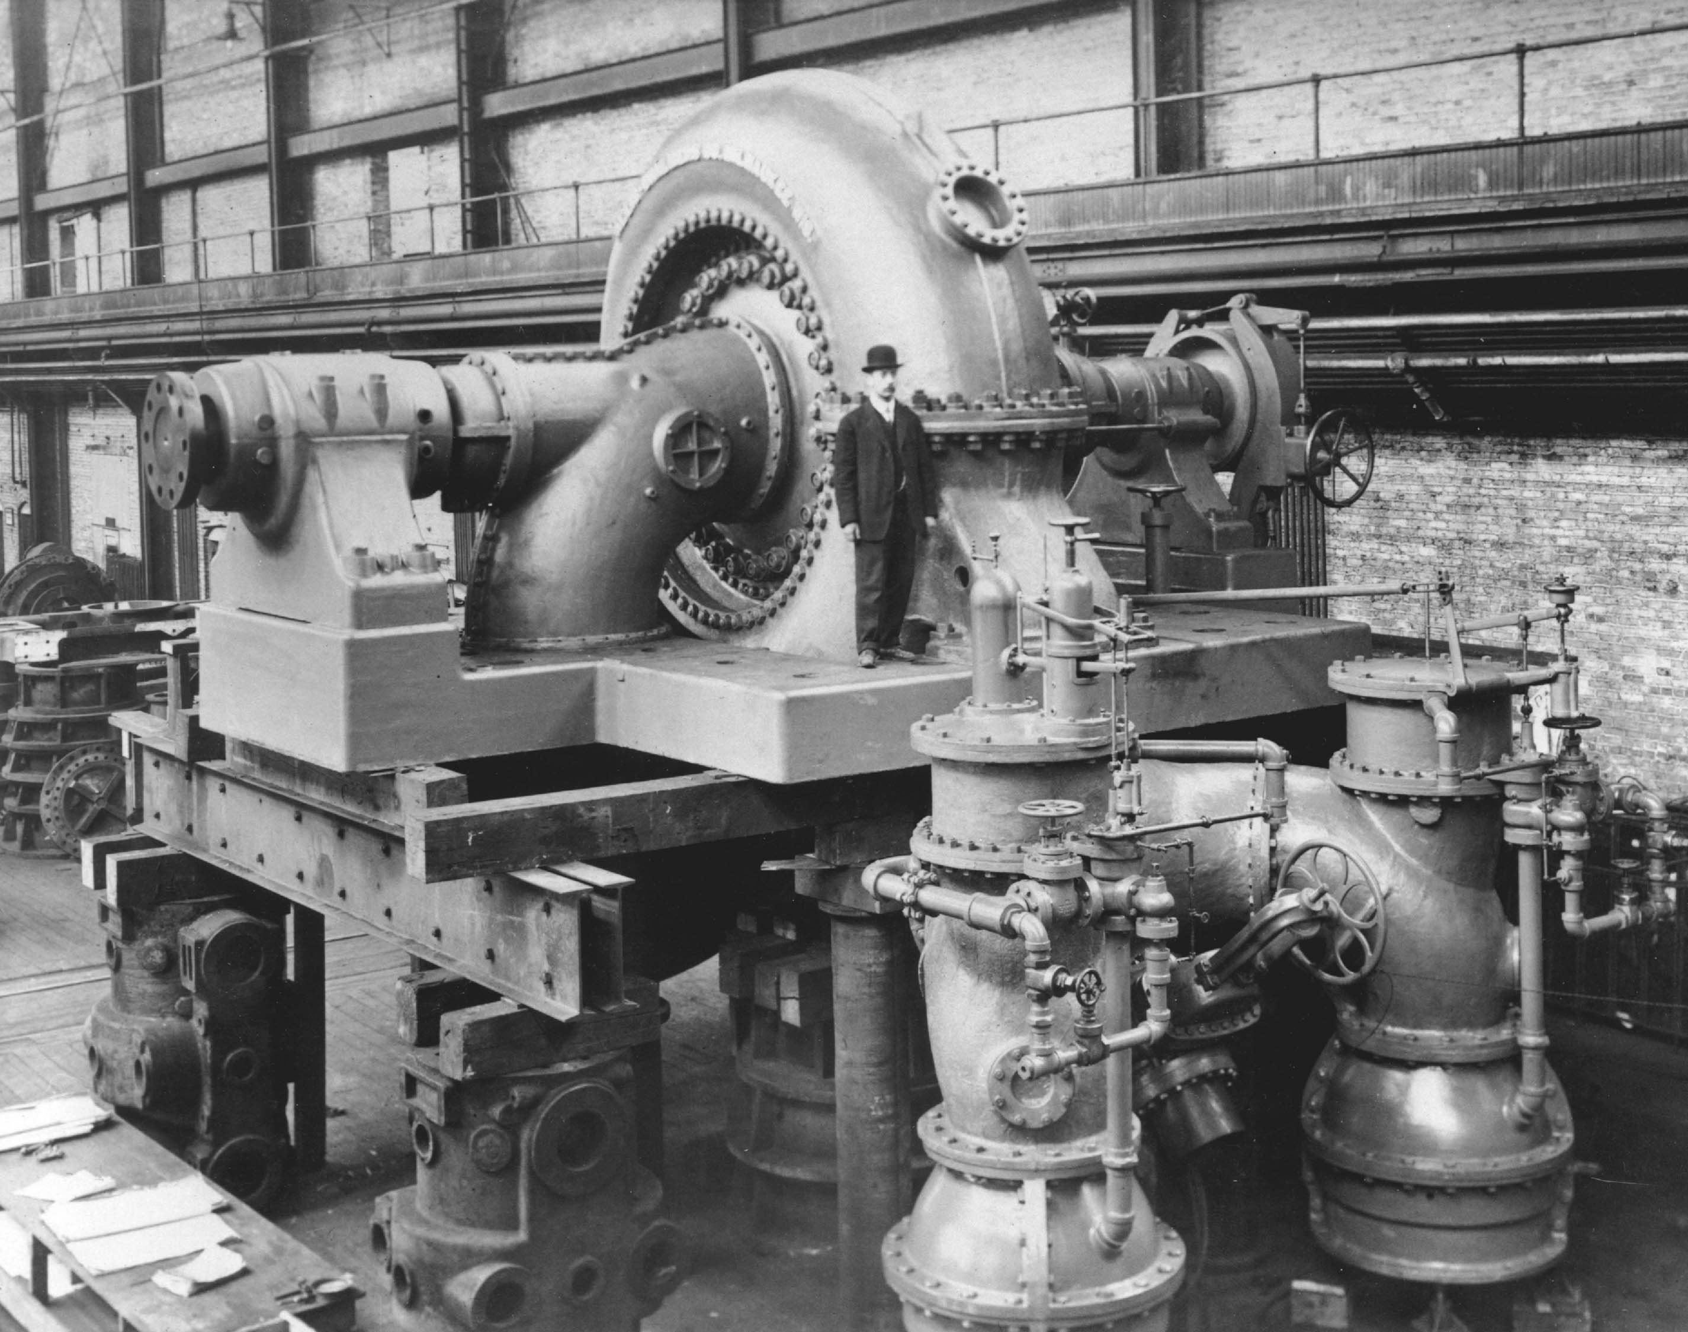
Powerhouse turbine #1, 1911

Slide 15
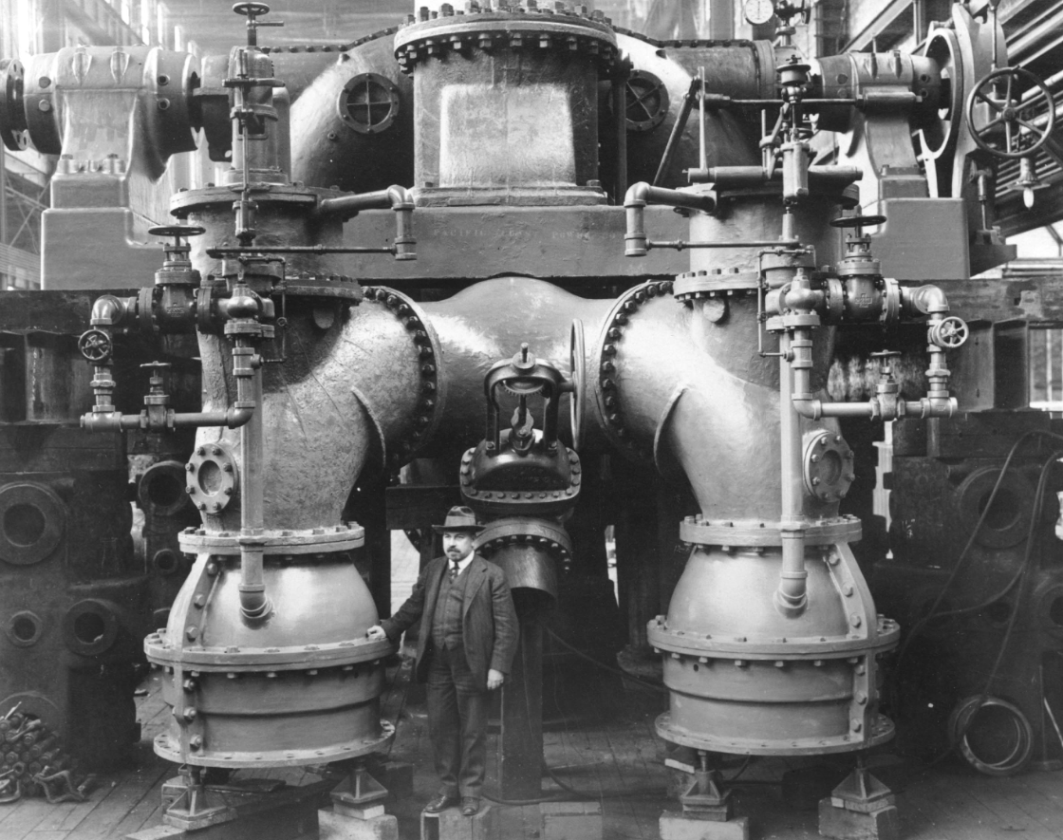
Powerhouse turbine pressure relief valve detail; the man’s hand is on the 450 cfs pressure relief valve, behind him is the 16” bypass valve, 1911

Slide 16
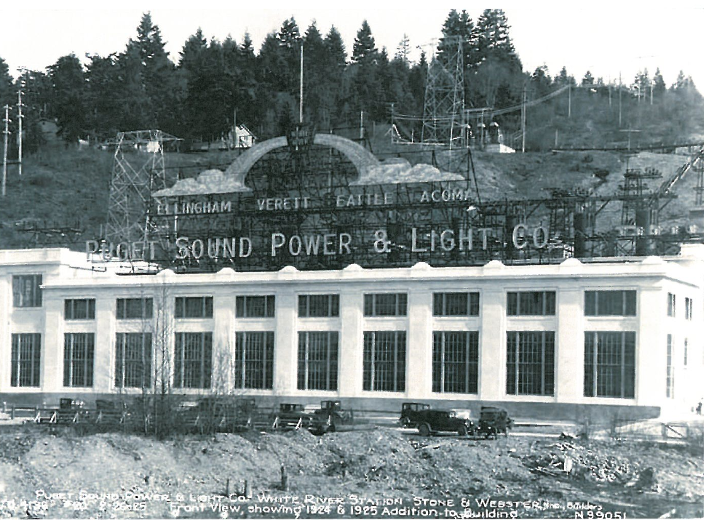
Powerhouse, 1925. The higher building to the north is the 1923 addition.

Slide 17
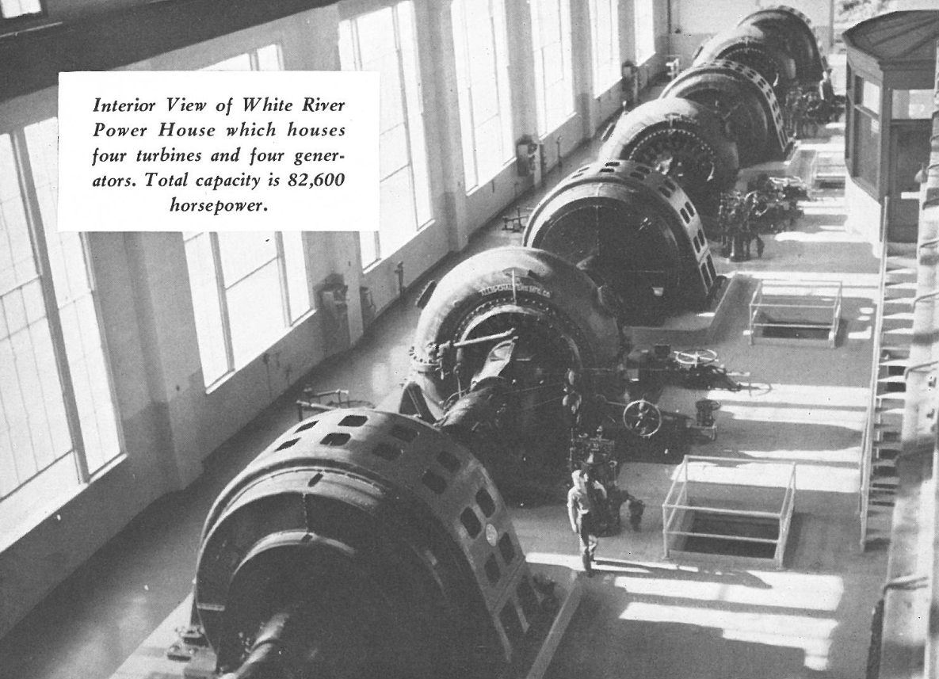

Slide 18
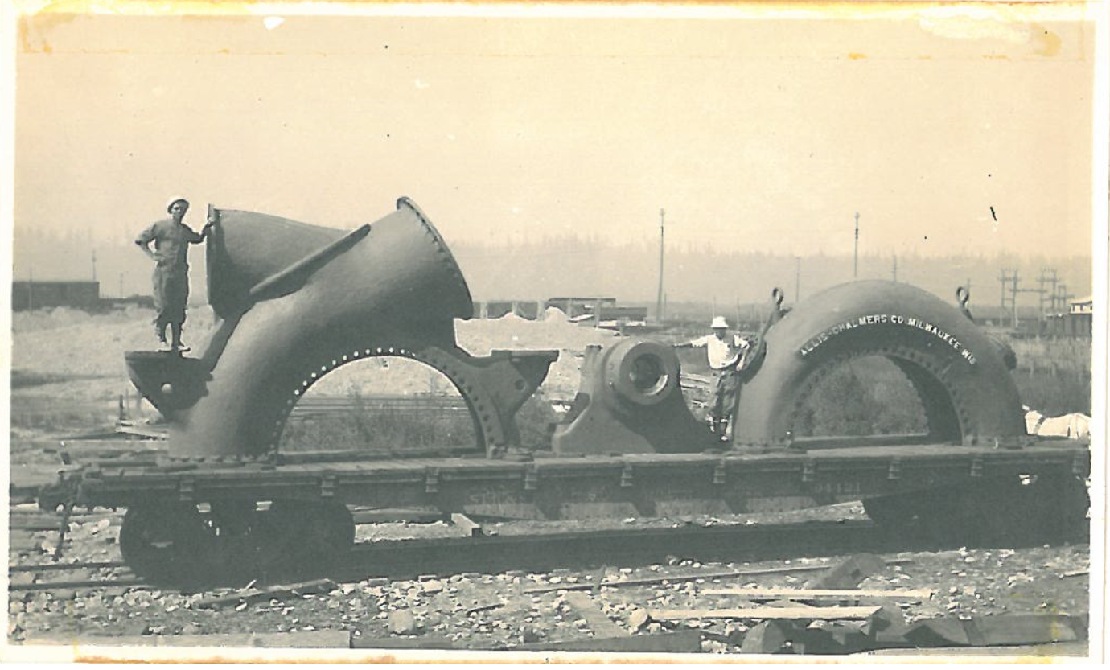
Sections of turbine casing and bearing on railroad flatcar, circa 1911.

Slide 19
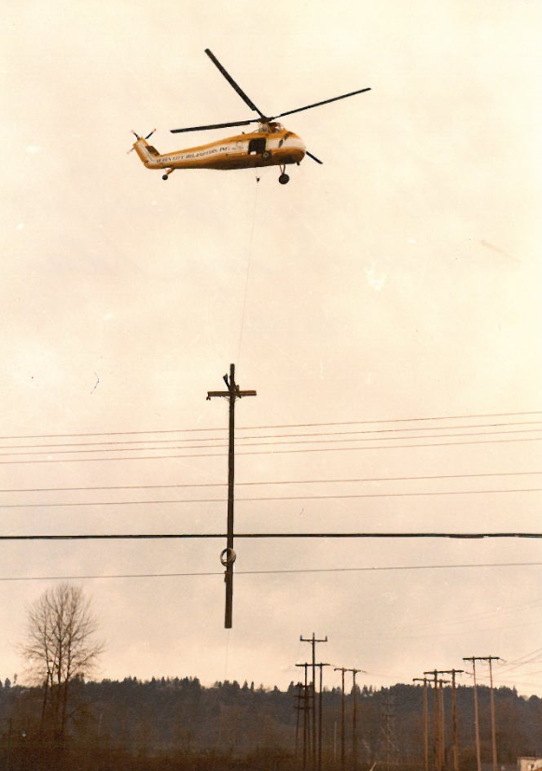
Sikorsky helicopter transporting power pole

Slide 20
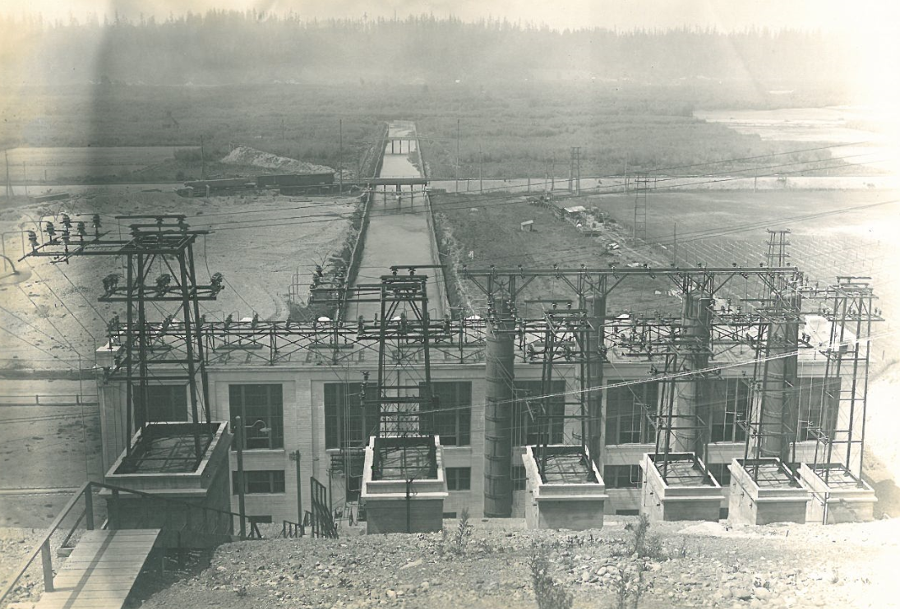
View from back of Powerhouse and tailrace, Railroad Bridge and 148th Street bridge. Row of concrete buildings in foreground supported towers for power up the hillside; towers are now gone, but buildings are still there.

Slide 21
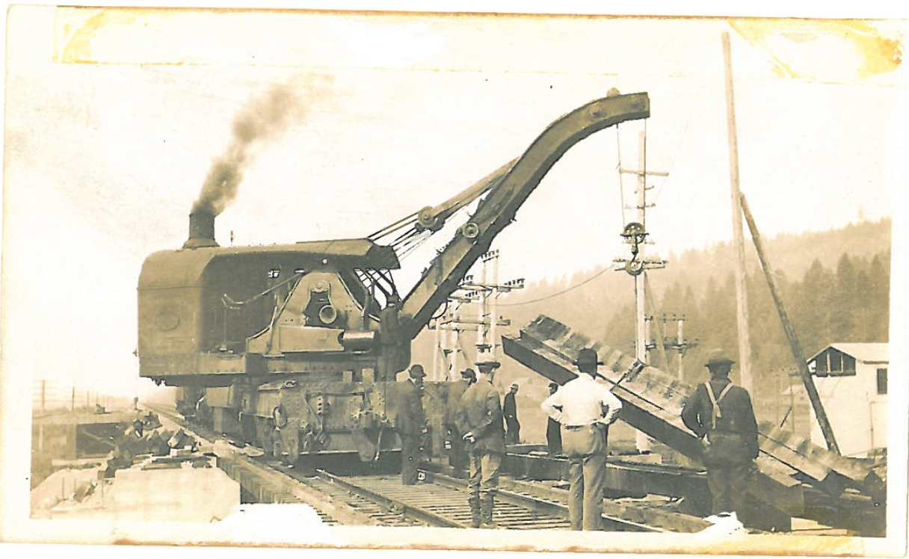
Construction of railroad bridge across Tailrace channel using a steam powered crane.

Slide 22
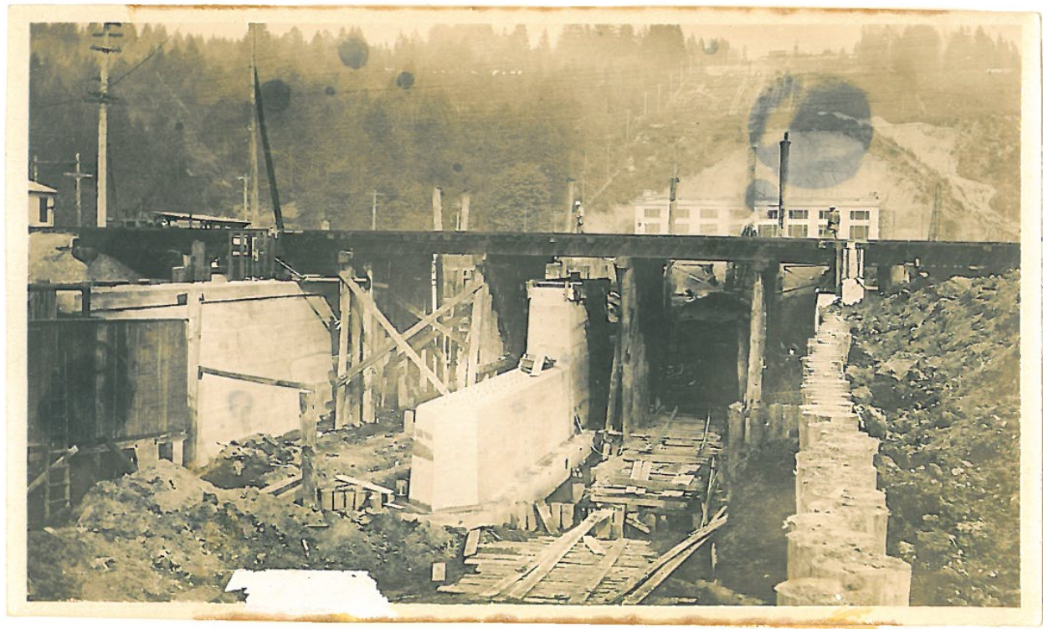
Concrete abutment to protect the railroad bridge from the water flow.

Slide 23
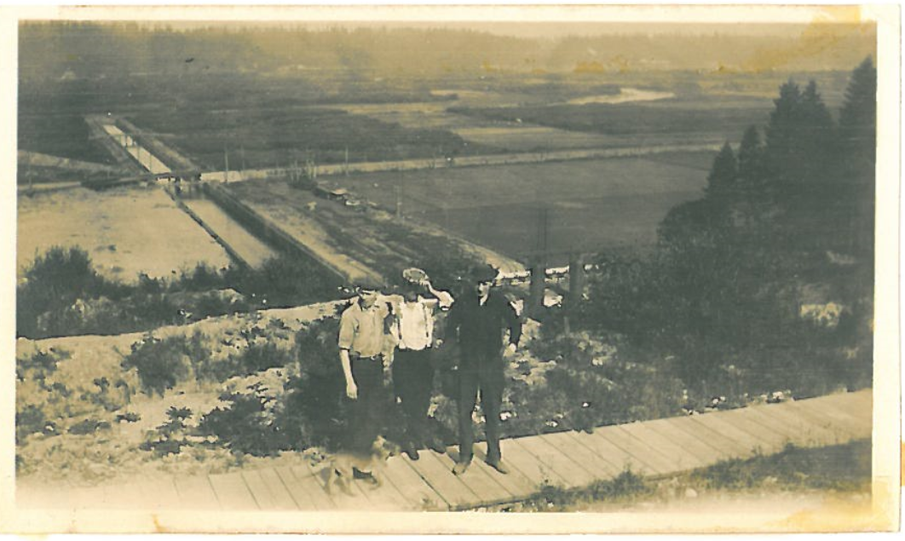
On Cottage Road, where 4-1 and 4-2 standpipes buildings were later built. Finished Tailrace channel filled with water in background.

Slide 24
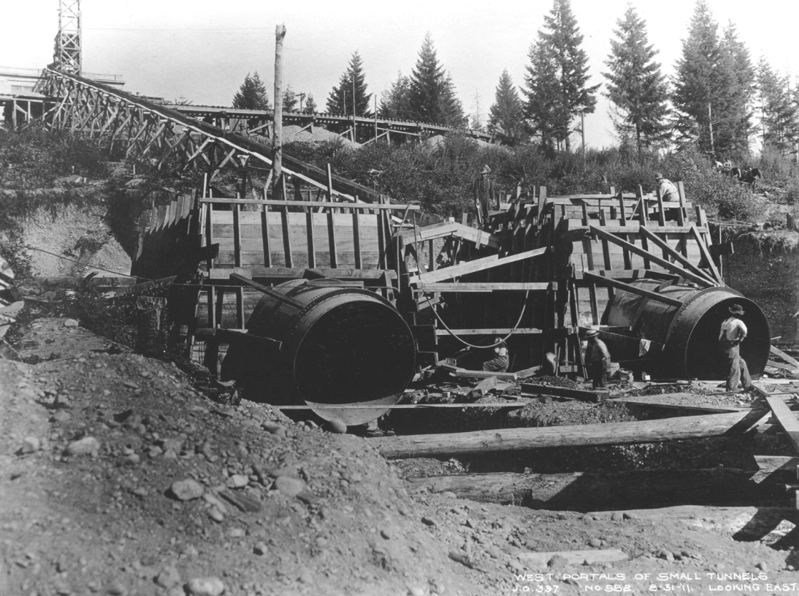
West portals of Penstocks 1 and 2, 8-31-1911

Slide 25
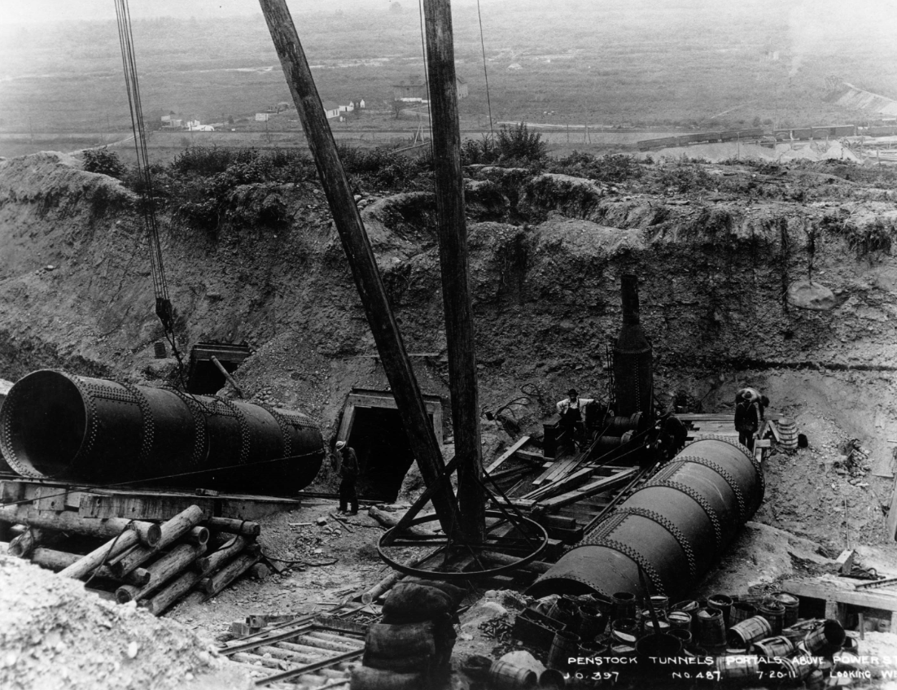
Penstock tunnels, possibly going in to Forebay, 7-20-1911

Slide 26
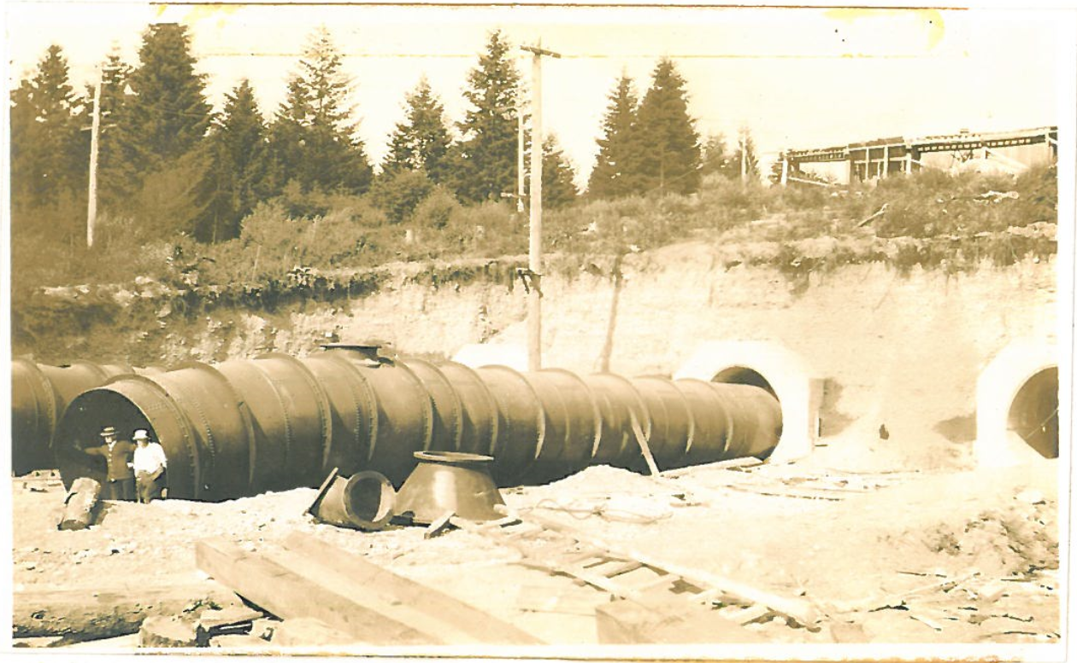
Penstocks 1 and 2 coming out of Forebay (under construction on top of hill), 7-20-1911

Slide 27
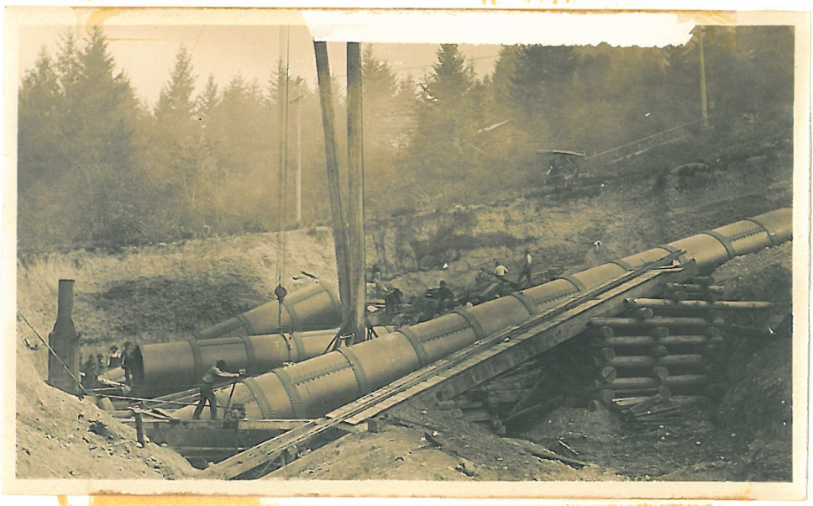
Penstocks going into the Powerhouse or Forebay. 1911

Slide 28
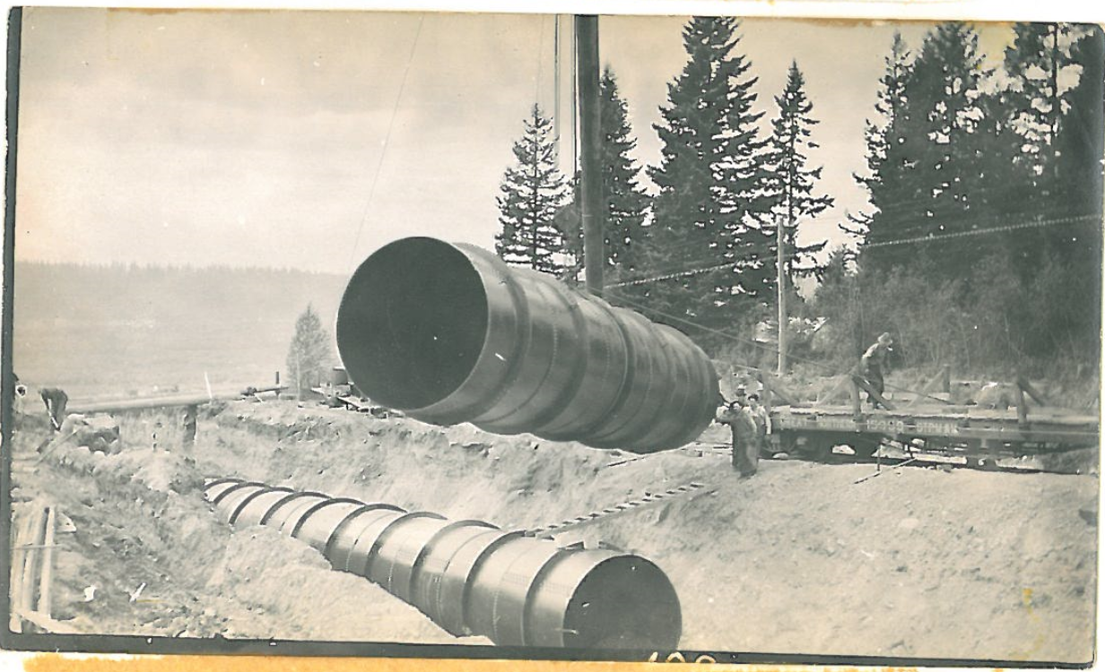
Unloading penstock section from railroad flatcar, 1911

Slide 29
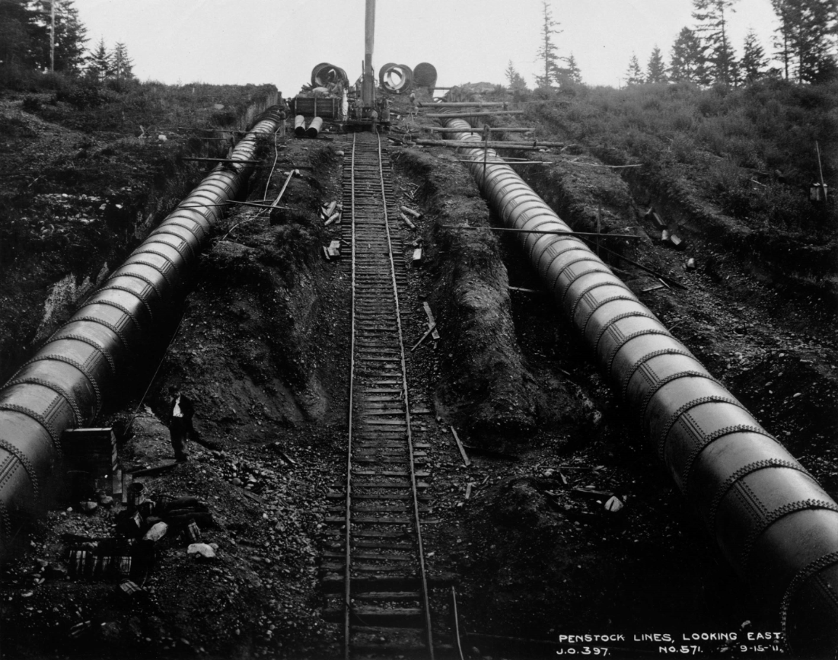
Penstocks 1 (left) and 2 (right). Railroad track and boom in middle to set pipe. 9-15-1911

Slide 30
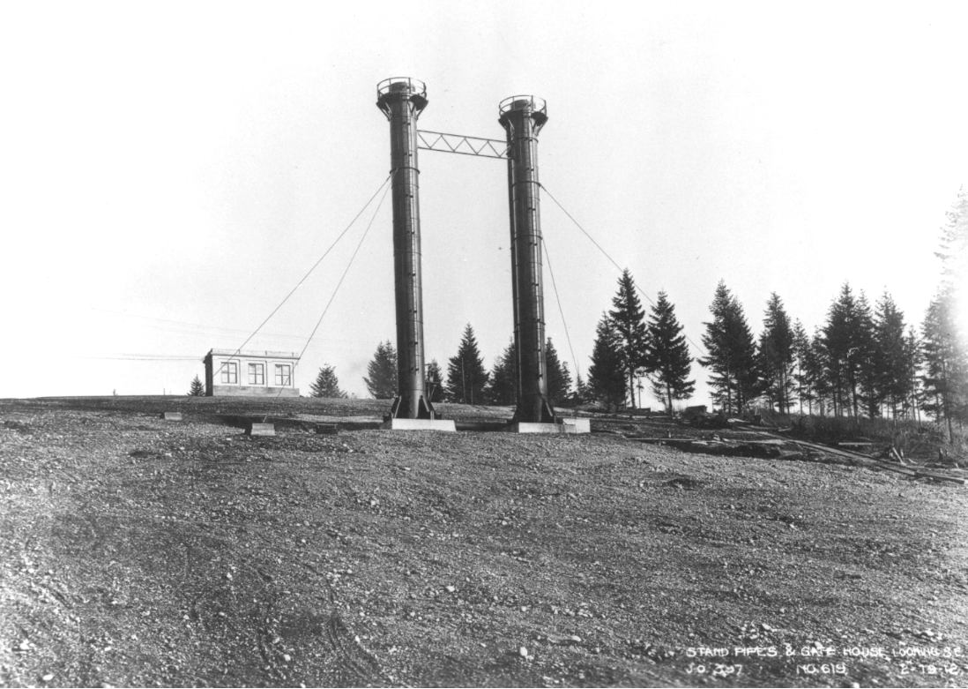
Stand pipes for 1 (left) and 2 (right) and gatehouse. Standpipe 3 not yet constructed. Building in background is Forebay. 2-19-1912

Slide 31
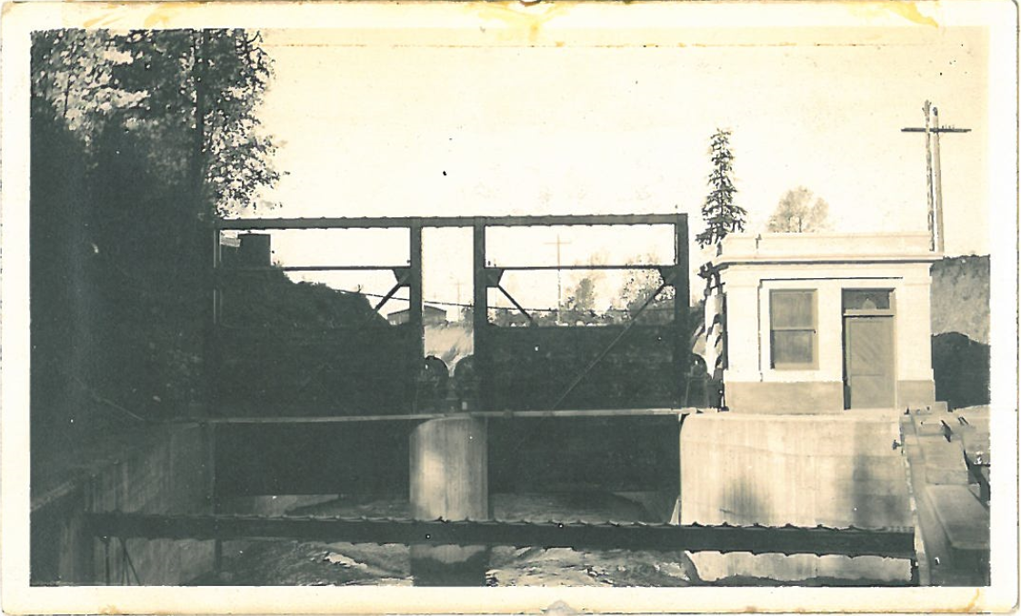
Gatehouse and intake gate to Flume at Diversion Dam near Buckley

Slide 32
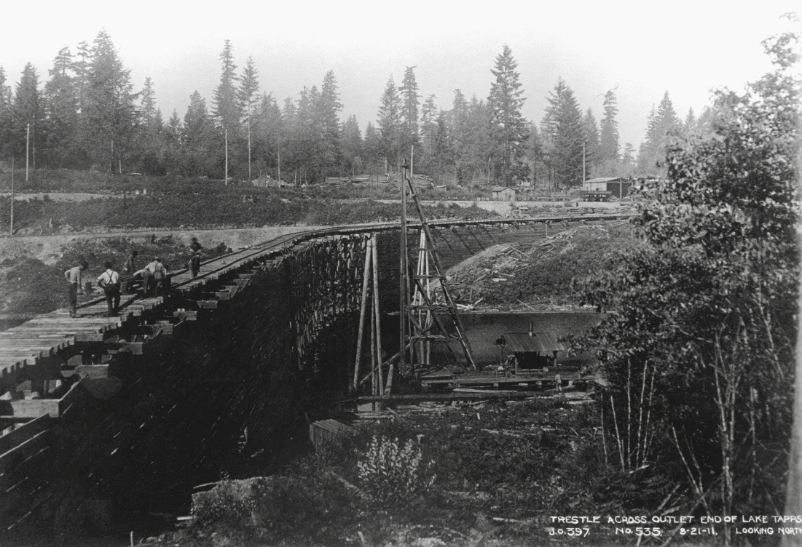
Trestle for railroad across outlet end of Lake Tapps, possibly Fairweather Cove trestle, 8-21-1911

Slide 33
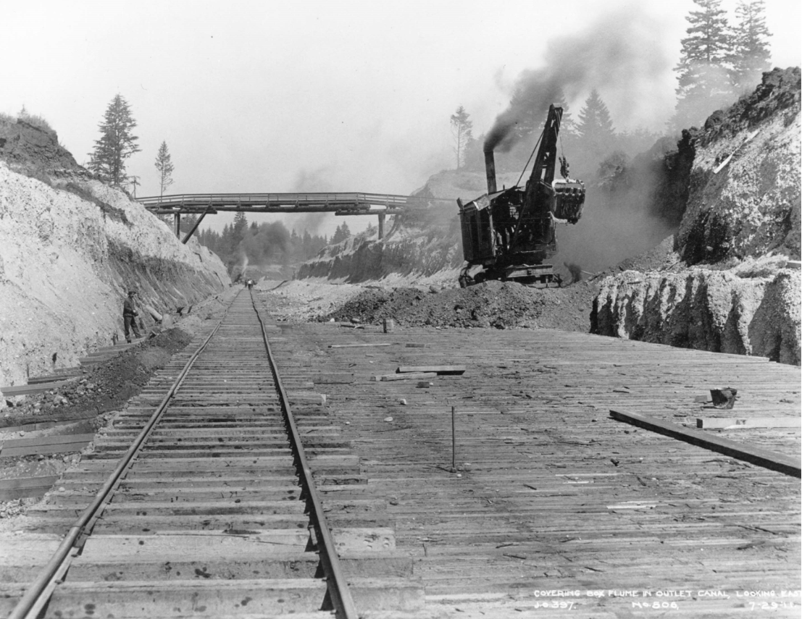
Covering the box flume in outlet canal near Sumner-Buckley Highway Bridge with steam powered shovel, 7-29-1911

Slide 34
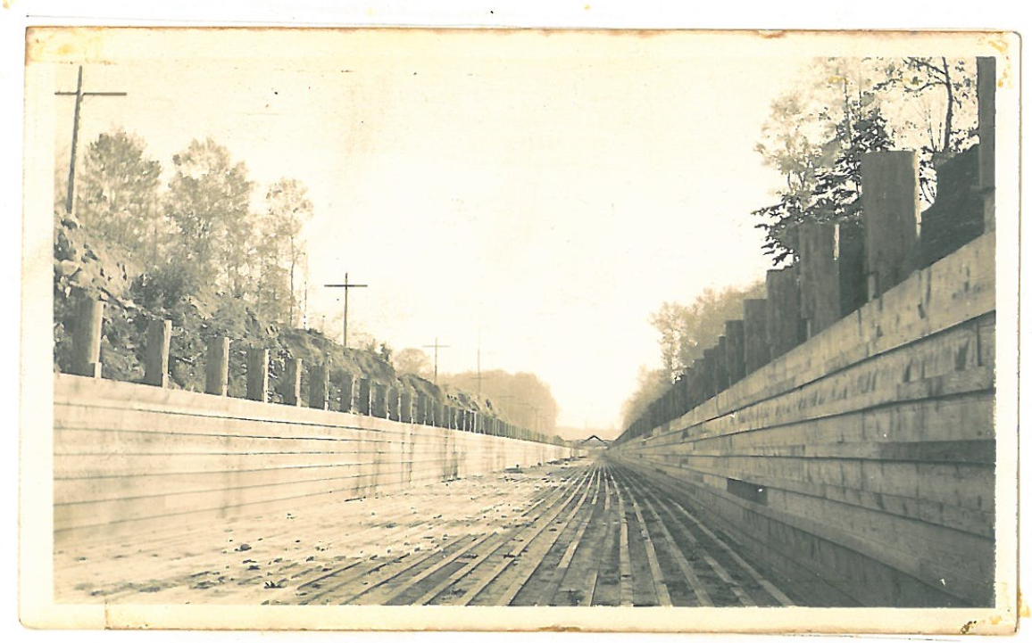
Wooden flume at headworks, circa 1911

Slide 35
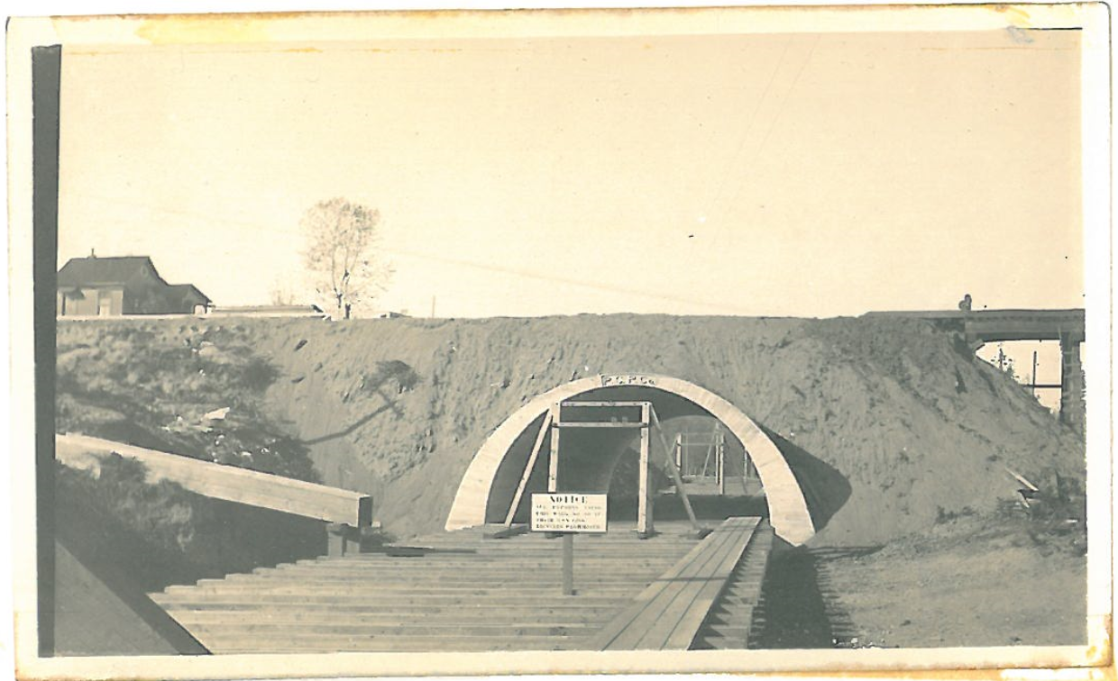
Flume going underneath the P&G Company Railroad, which is now a Rails-to-Trails walking path. Circa 1911

Slide 36
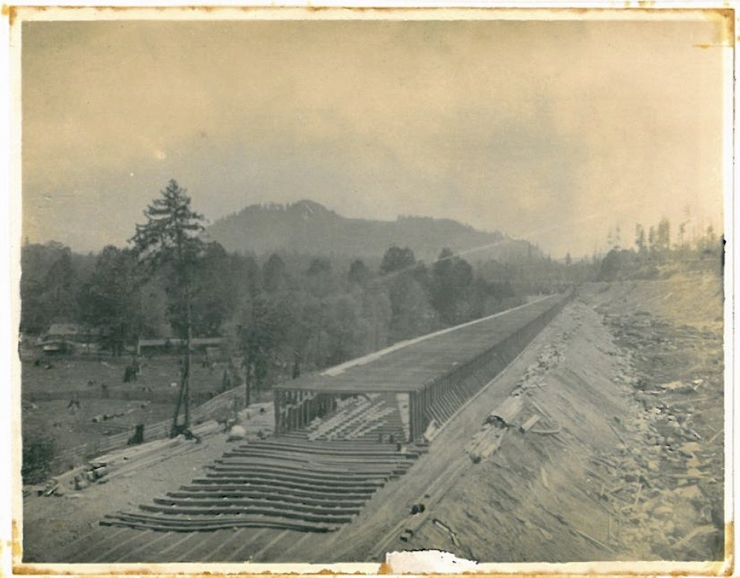
Constructing the flume, probably leaving the headworks, circa 1911

Slide 37
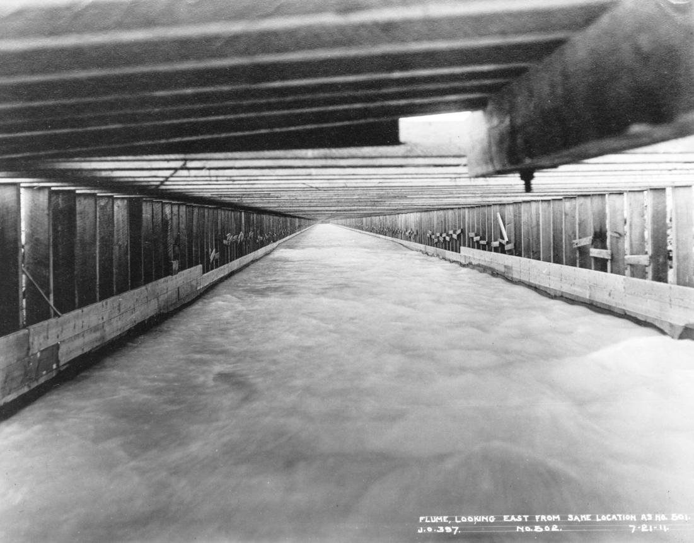
Camera on suspended platform in flume, 7-21-1911

Slide 38
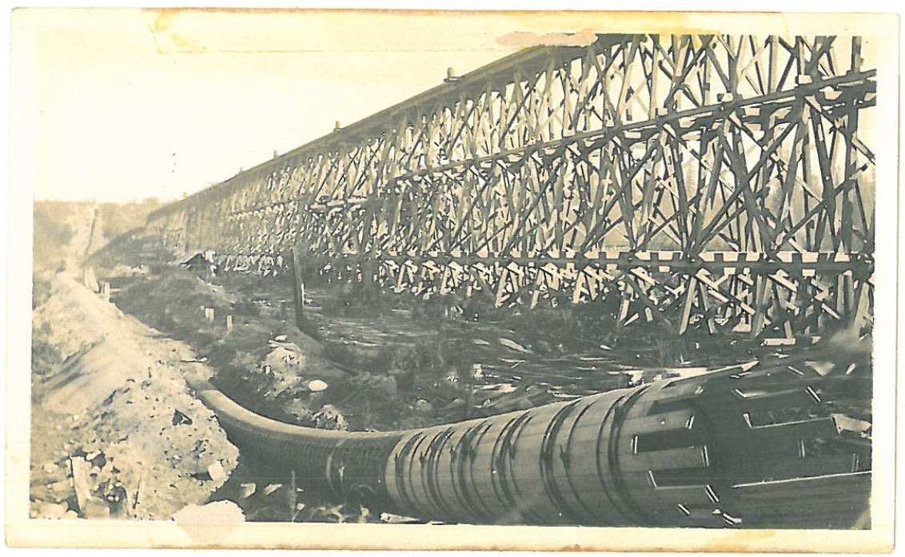
Wood stave water line under construction (possibly used for sluicing) and railroad trestle (possibly used for building Dike 4). Circa 1911.

Slide 39
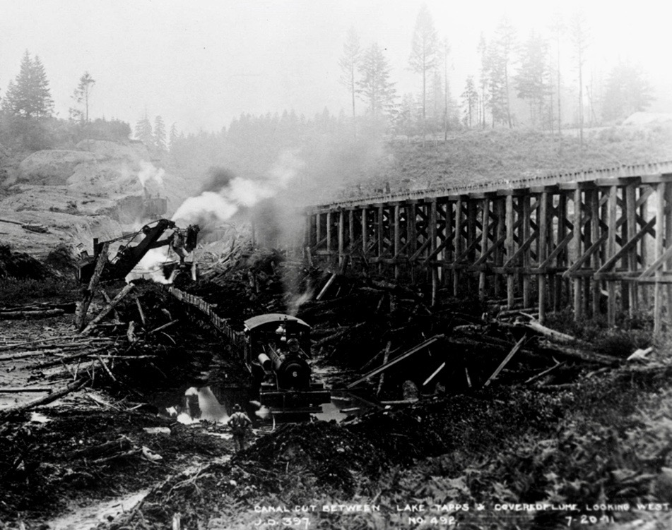
Canal cut between Lake Tapps and covered flume, 7-20-1911

Slide 40
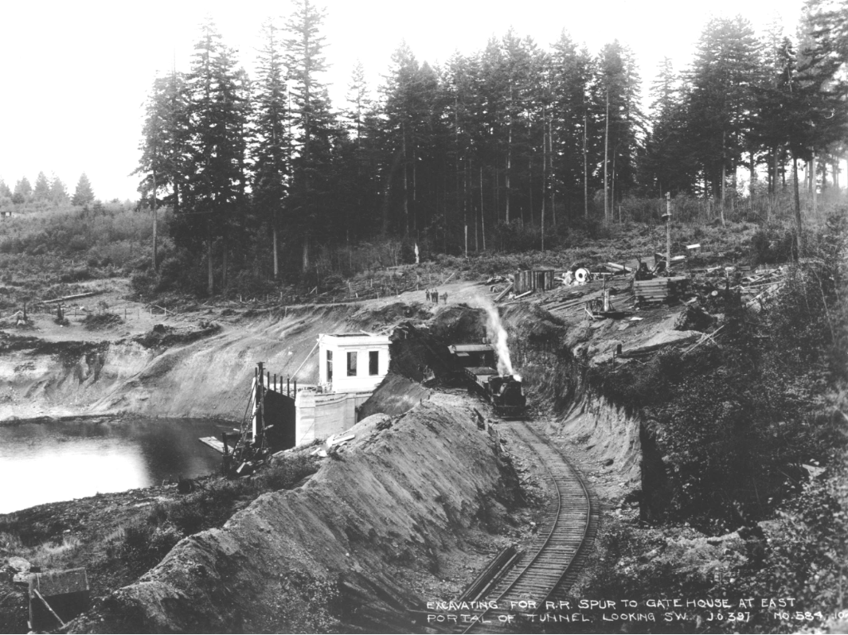
Excavating for railroad spur to Tunnel Intake, 1911

Slide 41
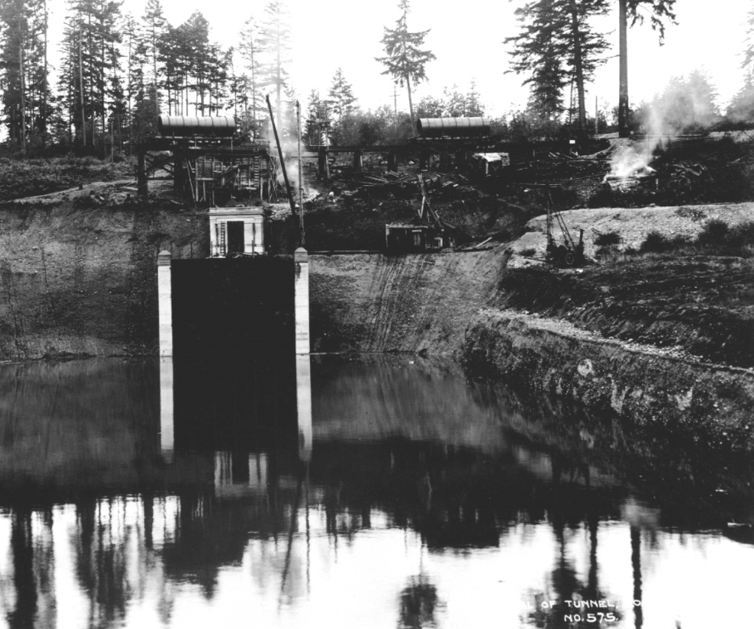
Tunnel intake with railroad spur, 1911

Slide 42
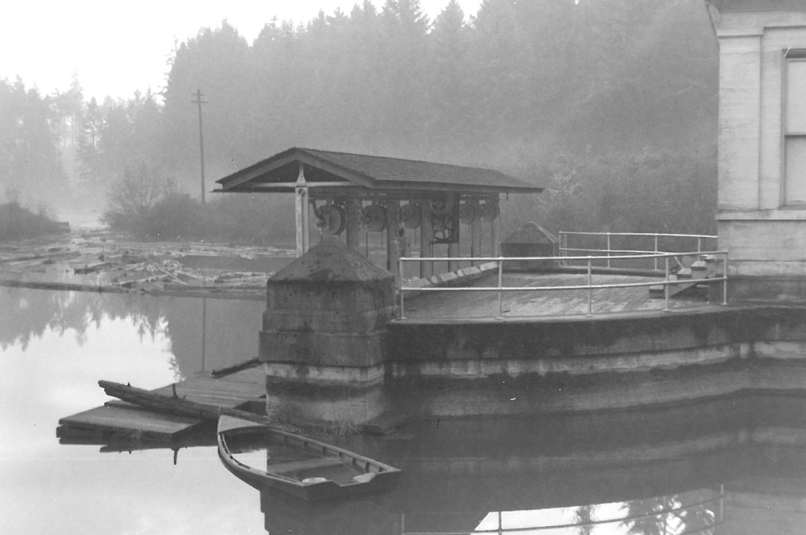
Tunnel intake house trash rack cleaners (removed in 2014), Dec 1954

Slide 43
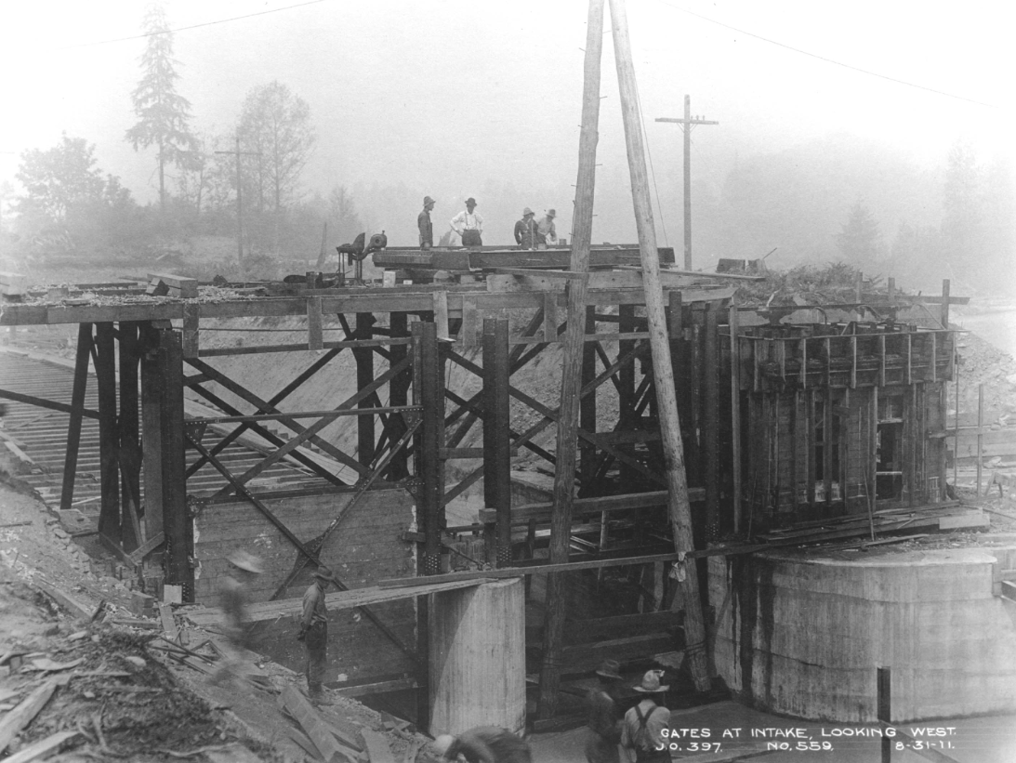
Construction of intake structure and gates, 8-31-1911

Slide 44
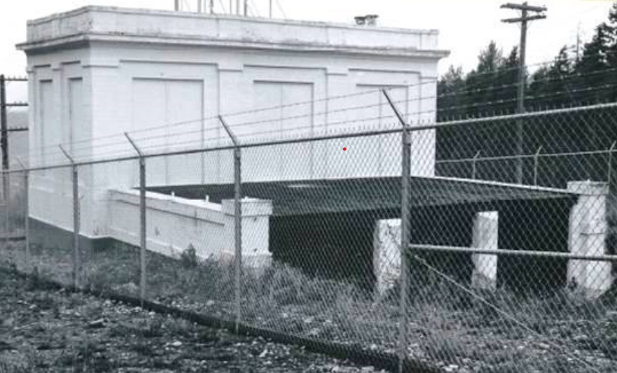
Forebay, between 1950 and 1960.

Slide 45
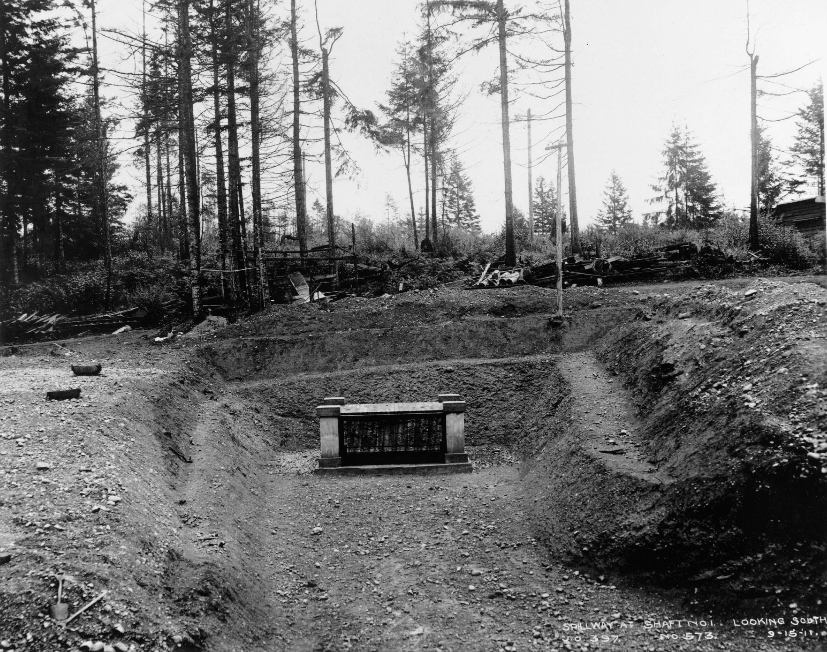
Bear Trap connected to the tunnel, 9-16-1911

Slide 46
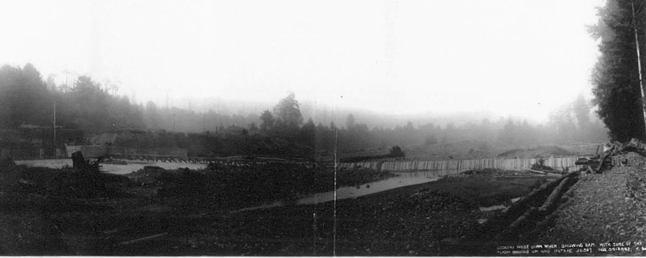
Barrier Dam

Slide 47

These photos are property of Cascade Water Alliance and may be reprinted with permission only.

